Slide 1
DO NOW- What do you know?
What is a green career? [1] ___________________________
Identify in the mind map below examples of green careers. Try to list 5. [1 for each]
Environmental Scientist
Green Careers
Wind Turbine Technician
3) Can you describe the issues we are currently facing as to why we need green jobs? [2] ____________________________________________________________________________________________________________________________________________________________________________________________________________________________________________________________________________________
4) Explain the importance of the green jobs to Earth. [3]
________________________________________________________________________________________________________________________________________________________________________________________________________________________________________________________________________________________________________________________________________________________________________________

Slide 2
DO NOW- ANSWERS PURPLE PEN
What is a green career? [1] Employment in an activity that contributes to protecting or restoring the environment, including those that mitigate or adapt to climate change.
Identify in the mind map below examples of green careers. Try to list 5. [1 for each] Award others.
Environmental Architect
Recycling Coordinator
Environmental Scientist
Green Careers
Sustainable Agriculture Specialist
Wind Turbine Technician
Electric Vehicle (EV) Engineer
Air Quality Specialist
Environmental Economist
3) Can you describe the issues we are currently facing as to why we need green jobs? [2] We need green jobs because climate change and pollution are damaging the planet, and natural resources are being depleted by unsustainable practices [1]. Green jobs help reduce emissions, protect ecosystems, and promote sustainable use of resources for a healthier environment. [1]
4) Explain the importance of the green jobs to Earth. [3]
Green jobs are important to Earth because they help protect the environment [1], they reduce pollution and greenhouse gas emissions, and promote sustainable use of natural resources [DEV]. By focusing on renewable energy, conservation, and eco-friendly practices, green jobs support a healthier planet and help fight climate change. [DEV[

Slide 3

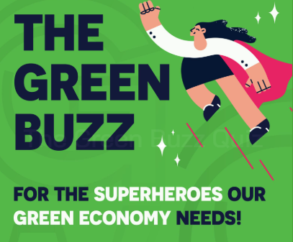

An introduction to Green Careers
Slides by ISEP, the Institute of Sustainability and Environmental Professionals

Slide 4
Opening questions
Are you are concerned about the planet?
Can anybody describe some of the problems that we are facing?
Can you name any green jobs?
Notes:
Teacher notes:
This could be a starter activity for learners, the purpose is to get them to think about what matters to them in terms of the environment and planet. It sets the scene for the rest of the presentation, and hopefully they will be able to provide more answers after the session.
Question 2 – see slide 5
Question 3 – definition of green jobs: Employment in an activity that contributes to protecting or restoring the environment, including those that mitigate or adapt to climate change.
Examples can be found at these links, or later in the slide deck
https://www.greencareershub.com/find-your-green-role/job-profiles
https://www.greencareershub.com/find-your-green-role/partner-career-stories/
https://www.greencareershub.com/find-your-green-role/live-jobs/
https://www.greencareershub.com/find-your-green-role/career-stories/

Slide 5
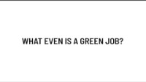
What is the Green Economy?
Why is it important?
Notes:
https://youtu.be/_d9Bp2ju2jg?list=TLGGMwDFGbfNIvgyMjEwMjAyNQ

Slide 6
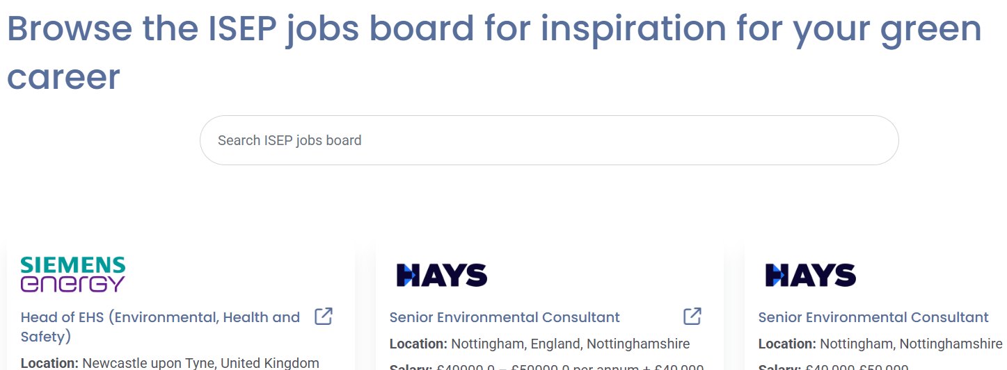
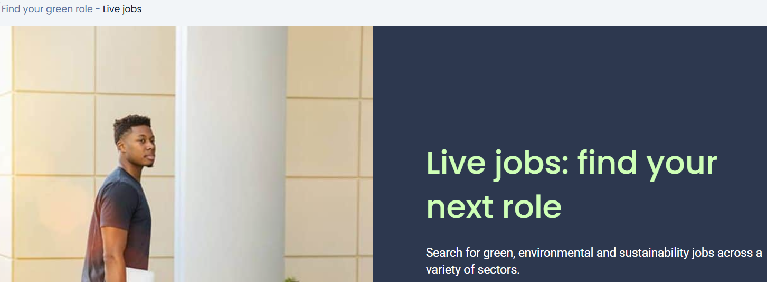
What job would you choose to save your planet?
  https://www.greencareershub.com/find-your-green-role/live-jobs/
Live jobs currently:
Notes:
Teacher notes:
Explore some of the current jobs on the labour market with Green Careers. Ask students to choose one job and to give a reason why.
Examples can be found at these links, or later in the slide deck
https://www.greencareershub.com/find-your-green-role/job-profiles
https://www.greencareershub.com/find-your-green-role/partner-career-stories/
https://www.greencareershub.com/find-your-green-role/live-jobs/
https://www.greencareershub.com/find-your-green-role/career-stories/

Slide 7
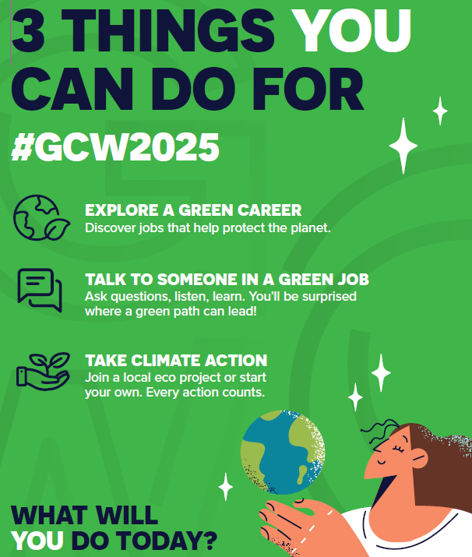

Careers and subjects quiz: sustainability

Slide 8
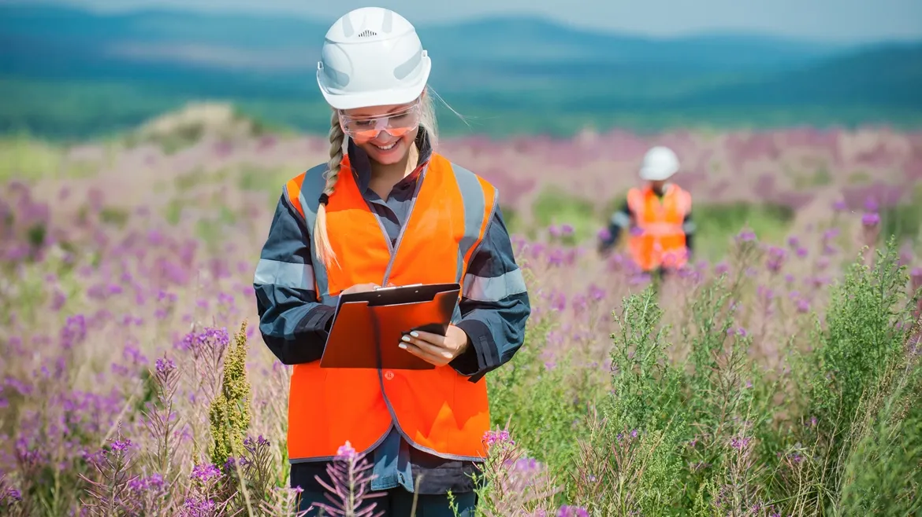
Question one
Which of the following is NOT a typical part of an environmental planner’s role?
Calculating flood risk
Making sure companies follow environmental standards and laws
Building structures that meet sustainability regulations
Notes:
Teacher’s notes:
Click to display three possible answers for students to select from.
Click again to reveal the correct answer on the next slide.
Answers are recapped on slide twelve, after the five quiz questions have been presented.

Slide 9
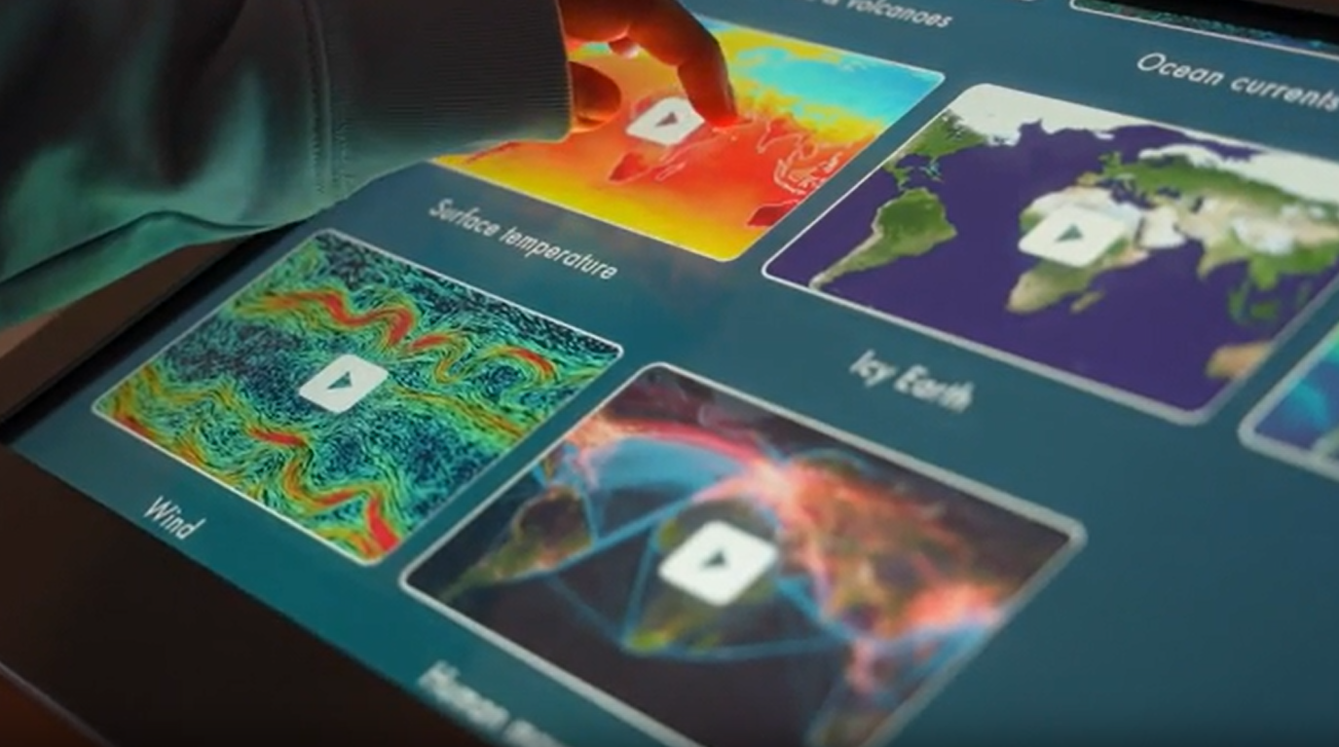
Question two
Fill in the gaps!
If you enjoy _________ or _________ and have an interest in environmental or conservation issues, studying a degree in environmental and earth sciences could be for you.
Maths or psychology
Science or geography
English or history
Notes:
Teacher’s notes:
Click to display three possible answers for students to select from.
Click again to reveal the correct answer on the next slide.
Answers are recapped on slide twelve, after the five quiz questions have been presented.

Slide 10
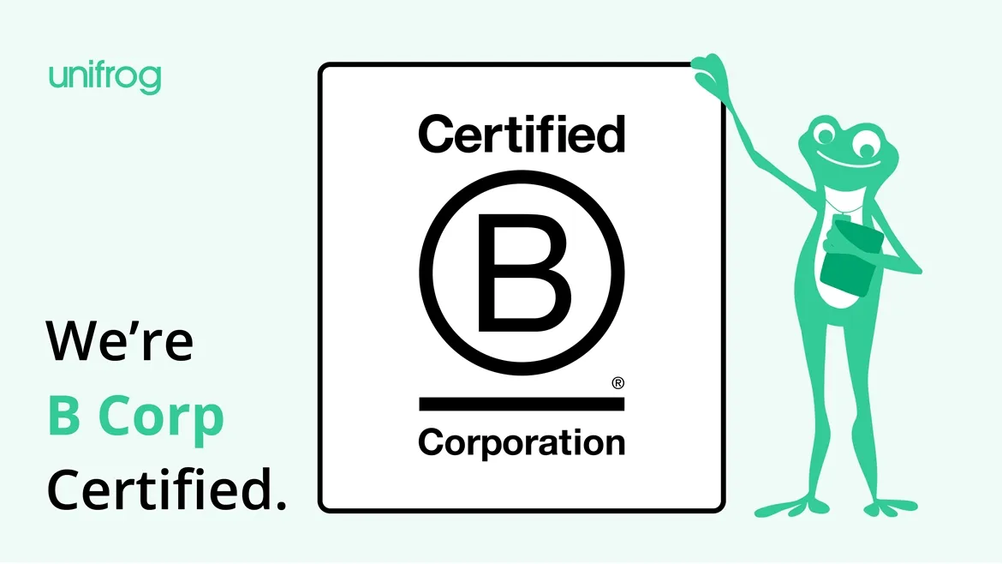
Question three
What accreditation is given to companies that meet high standards for social impact, including sustainability?
A Corp
B Corp
C Corp
Notes:
Teacher’s notes:
Click to display three possible answers for students to select from.
Click again to reveal the correct answer on the next slide.
Answers are recapped on slide twelve, after the five quiz questions have been presented.

Slide 11
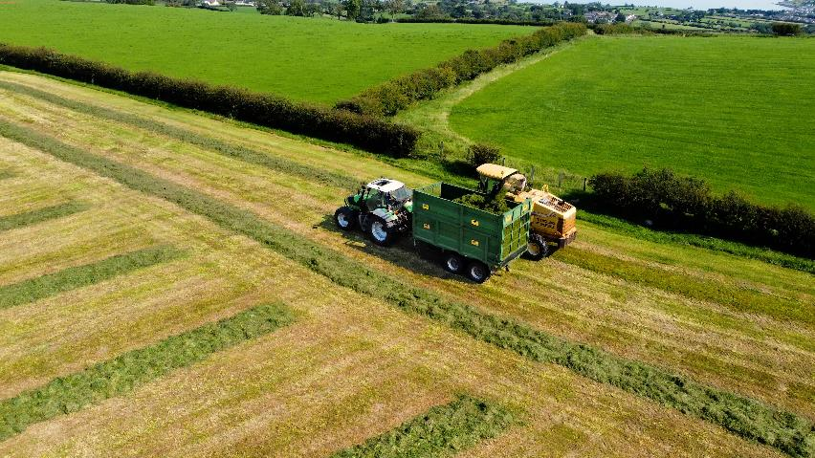
Question four
Which university degree is described below?
Combines studying natural and life sciences with economics and business management. You learn how to maximise crop and animal production and how to balance this with environmental awareness, as well as business skills to run a farm.
Agriculture
Horticulture and botany
Biology and biological sciences
Notes:
Teacher’s notes:
Click to display three possible answers for students to select from.
Click again to reveal the correct answer on the next slide.
Answers are recapped on slide twelve, after the five quiz questions have been presented.

Slide 12

Question five
Hertfordshire Zoo is both a zoo and a conservation charity. What job role at the company is described below?
Communicating how zoos support conservation and help save species across the globe, delivering keeper talks, and running educational activities.
Horticulturist
Social media marketer
Conservation educator
Notes:
Teacher’s notes:
Click to display three possible answers for students to select from.
Click again to reveal the correct answer on the next slide.
Answers are recapped on slide twelve, after the five quiz questions have been presented.

Slide 13
Question one
Which of the following is NOT a typical part of an environmental planner’s role?
Building structures that meet sustainability regulations
An environmental planner normally works for an environmental consultancy firm. They give advice about new and existing projects. They typically wouldn’t be involved in construction themselves.
Notes:
Teacher’s notes:
Answers are recapped on slide twelve, after the five quiz questions have been presented.

Slide 14
Question two
Fill in the gaps!
If you enjoy _________ or _________ and have an interest in environmental or conservation issues, studying a degree in environmental and earth sciences could be for you.
Science or geography
Environmental and earth science modules can include: climate change, ecology, scientific modelling, forestry, marine sciences and oceanography, and biodiversity conservation.
Notes:
Teacher’s notes:
Answers are recapped on slide twelve, after the five quiz questions have been presented.

Slide 15
Question three
What accreditation is given to companies that meet high standards for social impact, including sustainability?
B Corp
B Corps are companies verified by B Lab that meet high standards of social and environmental performance, transparency, and accountability.
Notes:
Teacher’s notes:
Answers are recapped on slide twelve, after the five quiz questions have been presented.

Slide 16
Question four
Which university degree is described below?
Combines studying natural and life sciences with economics and business management. You learn how to maximise crop and animal production and how to balance this with environmental awareness, as well as business skills to run a farm.
Agriculture
Agriculture students gain practical skills on university-based farms and possibly out on placement.
Notes:
Teacher’s notes:
Answers are recapped on slide twelve, after the five quiz questions have been presented.

Slide 17
Question five
Hertfordshire Zoo is both a zoo and a conservation charity. What job role at the company is described below?
Communicating how zoos support conservation and help save species across the globe, delivering keeper talks, and running educational activities.
Conservation educator
Conservation educators also help to deliver sessions to school groups throughout the year.
Notes:
Teacher’s notes:
Answers are recapped on slide twelve, after the five quiz questions have been presented.

Slide 18
Answers
1 = C
2 = B
3 = B
4 = A
5 = C
c) Building structures that meet sustainability regulations. An environmental planner normally works for an environmental consultancy firm. They give advice about new and existing projects. They typically wouldn’t be involved in construction themselves.
b) Science or geography. Environmental and earth science modules can include: climate change, ecology, scientific modelling, forestry, marine sciences and oceanography, and biodiversity conservation.
b) B Corp. B Corps are companies verified by B Lab that meet high standards of social and environmental performance, transparency, and accountability.
a) Agriculture. Agriculture students gain practical skills on university-based farms and possibly out on placement.
c) Conservation educator. Conservation educators also help to deliver sessions to school groups throughout the year.
Notes:
Teacher’s notes:
Click to recap the five quiz question answers and supporting explanations.

Slide 19

What’s in this presentation?
Part 1: Introducing sustainability and the environment
What do we mean by sustainability?
Sustainable development goals
Explanation of key terms
Part 2: Green jobs and skills
Overview and examples of green jobs
Subjects and career routes
Part 3: Introducing the Green Careers Hub
Benefits of green jobs and myth-busters
Job spotlights and videos

Slide 20
Part 1: Introducing sustainability & the environment

Slide 21
What do we mean when we talk about sustainability?
Sustainability= Meeting the needs of the present without compromising the ability of future generations to meet their own needs.
Climate change
Social sustainability
Plastic pollution
Sustainable resource use
Biodiversity loss and natural restoration
Population growth
Write down what each of these are on your worksheet. Your teacher may help you.
Notes:
Teacher notes:
The most common definition of sustainable development is: Meeting the needs of the present without compromising the ability of future generations to meet their own needs.
You might hear the term climate change (climate change is a change in the long-term distribution and severity of weather patterns caused by changes in global temperature), or potentially net-zero, but it’s not just about that when it comes to sustainability, there are all these other elements to consider. Low-carbon is also used frequently. In the UK, we have a target of reaching net zero by 2050. Useful resource on climate change from the Met Office: https://weather.metoffice.gov.uk/climate-change/what-is-climate-change
Social sustainability - being socially inclusive helps to ensure equal opportunities to individuals worldwide, so that everyone can achieve their full potential in life. Vulnerable communities are often the worst-hit by disasters, but they don’t produce the highest amount of greenhouse gases. The term just transition refers to a fair green economy, ensuring equal opportunities. Social sustainability means creating a world where people can live happy, healthy lives now and in the future. It’s about making sure everyone has what they need—like safe and clean environment, good mental and physical health and fair opportunities while protecting nature for future generations to enjoy.
Plastic pollution – microplastics being found in the ocean – all plastic still exists in some forms. Thinking about different materials that can be used
Sustainable resource use - this relates to the term circular economy as well: reuse, repair recycle at the end of lifespan.
Biodiversity loss - to preserve resources, we need to reduce the negative impacts that we have on nature. Across the UK species studied have declined on average by 19% since 1970. Protecting biodiversity; plants, wildlife, clean air and water all feed into this area.
Population growth – too many people for the earth’s resources

Slide 22
What do we mean when we talk about sustainability?
Sustainability= Meeting the needs of the present without compromising the ability of future generations to meet their own needs.
Climate change
Social sustainability
Plastic pollution
Sustainable resource use
Biodiversity loss and natural restoration
Population growth

Slide 23
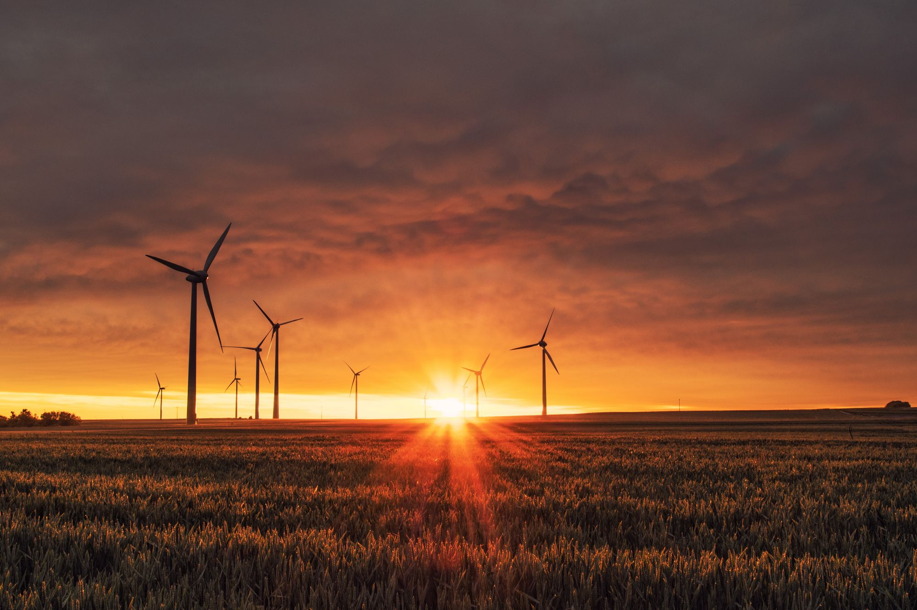
Answers
Climate change is a change in the long-term distribution and severity of weather patterns caused by changes in global temperature….
Climate change
…..or potentially net-zero, but it’s not just about that when it comes to sustainability, there are all these other elements to consider. Low-carbon is also used frequently. In the UK, we have a target of reaching net zero by 2050.

Slide 24
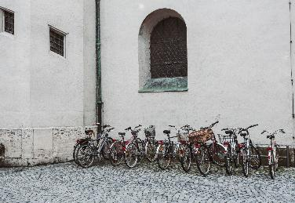
Answers
Social sustainability - being socially inclusive helps to ensure equal opportunities to individuals worldwide, so that everyone can achieve their full potential in life. Vulnerable communities are often the worst-hit by disasters, but they don’t produce the highest amount of greenhouse gases. The term just transition refers to a fair green economy, ensuring equal opportunities.
Social sustainability
Its about making sure everyone has what they need—like safe and clean environment, good mental and physical health and fair opportunities while protecting nature for future generations to enjoy.

Slide 25
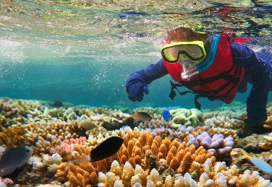
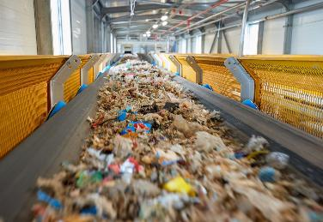
Answers
Plastic pollution – microplastics being found in the ocean – all plastic still exists in some forms.
Plastic pollution
Sustainable resource use - this relates to the term circular economy as well: reuse, repair recycle at the end of lifespan.
Sustainable resource use

Slide 26

Answers
Biodiversity loss - to preserve resources, we need to reduce the negative impacts that we have on nature.
Across the UK species studied have declined on average by 19% since 1970. Protecting biodiversity; plants, wildlife, clean air and water all feed into this area.
Biodiversity loss and natural restoration

Slide 27
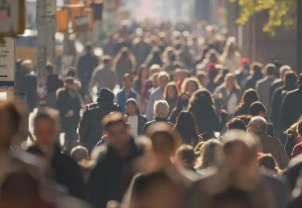
Answers
Population growth – too many people for the earth’s resources
As we enter a world population of 8 billion on the planet, resources such as water and food, are becoming more scarce. Pressures on the planet become increasingly concerning.
Population growth

Slide 28

Key terms
Environment:
The environment is the surroundings and the conditions of a person, plant, or animal. It is where they live or operate.
Lots of complicated factors work together to create any given environment. They are physical and chemical, and the environment is also shaped by other living organisms. The environment changes the form and survival of individual living things and ecological communities.
Social sustainability:
Social sustainability means creating a world where people can live happy, healthy lives now and in the future. It’s about making sure everyone has what they need—like safe and clean environment, good mental and physical health and fair opportunities while protecting nature for future generations to enjoy.
Notes:
Teacher notes: useful definitions (can be kept for your use or to share with students)

Slide 29
Key terms continued
Net zero:
When the amount of greenhouse gas produced is equal to the amount removed from the atmosphere, we have net zero. Amounts produced and amounts removed must be balanced carefully. We reach net zero when the amount of greenhouse gas added is no more than the amount taken away. Individuals, companies, and countries can all aim to reach their own net zero.
Renewable energy:
Renewable energy is energy that comes from a source that won’t run out. They are natural and self-replenishing, and usually have a low- or zero-carbon footprint. Examples of renewable energy sources include wind power and solar power.
Carbon footprint:
A carbon footprint is a measurement of greenhouse gases (GHG) usually quoted in kilograms or tonnes of carbon dioxide equivalent – kgCO2e or tCO2e. GHGs include carbon dioxide, methane, nitrous oxide and a variety of F-Gases.
Notes:
Teacher notes: useful definitions (can be kept for your use or to share with students)

Slide 30
Key terms continued
Biodiversity:
Biodiversity refers to the variety of life. The UN Convention on Biological Diversity provides the following definition: “‘Biological diversity’ means the variability among living organisms from all sources including, interalia, terrestrial, marine and other aquatic ecosystems and the ecological complexes of which they are a part; this includes diversity within species, between species and of ecosystems.
Circular economy:
A Circular Economy is an alternative to a traditional linear economy (make, use, dispose) in which we keep resources in use for as long as possible, extract the maximum value from them whilst in use, then recover and regenerate products and materials at the end of each service life. This presents an obvious solution to the problem of resource scarcity.
Notes:
Teacher notes: useful definitions (can be kept for your use or to share with students)

Slide 31
Activity: test your knowledge
Discuss with a peer.
Can you name one of the top 5 wasted foods in the UK?
True or false: plastic waste stayed stable between the years 2000 and 2019 globally.
True or false: cyber espionage and warfare is considered a greater risk than nature resource shortages and biodiversity loss.
What has higher water use: an average person over one year or producing a single T-shirt?
Do you think that ecosystems can grow back after destruction (Y/N)?
Notes:
Teacher notes: answers below. The purpose of this activity is to engage students with different areas of sustainability and relate these to everyday life.

Slide 32
Activity: Correct your answers
Bread/Potatoes/Milk/Bananas/Salad & Vegs. Food waste is one of the major contributors to greenhouse gas emissions across the world. Food loss and waste account for 8-10% of annual global greenhouse gas emissions
False. It actually doubled. COVID-19 increased single-use plastic waste. In 2019 alone, 6.1 tonnes of plastic waste leaked into rivers, lakes and the ocean.
False. When looking at 10 year risks globally, 4 environmental issues come before cyber espionage.
Single t-shirt. It takes a lot of water to produce textile, plus land to grow cotton and other fibres. To make a single cotton t-shirt, 2,700 litres of fresh water are required according to estimates, enough to meet one person’s drinking needs for 2.5 years.
Yes. Chernobyl is a good example. And coral can regrow with the right conditions.

Slide 33

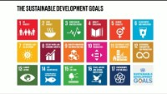
Notes:
Teacher notes:
The United Nations published 17 Sustainable Development Goals back in 2015
Businesses all over the world are using them as an easily understood and communicable framework and adopting their own objectives and targets aligned with the themes of the SDGs
The 17 SDGs provide a shared blueprint for peace and prosperity for people and the planet, now and into the future as well as an approach for companies and governments to frame sustainability issues.
Suggestion for discussion would be to ask the class to provide an example of each one and what they think it might refer to.
https://sdgs.un.org/goals - you can refer to these individually
https://www.youtube.com/watch?v=0XTBYMfZyrM

Slide 34
Exploring the SDGs
What one has your form decided to choose?
____________
1) What are the SDGs?
2) When were the developed?
3) Why have they been introduced?
4) Which ones link to Green Careers?
5) Choose one and explain how the school could implement this.
Notes:
Teacher notes:
https://sdgs.un.org/goals - explore one with your form at this address and the students can do extended study on how they could implement into the school.

Slide 35
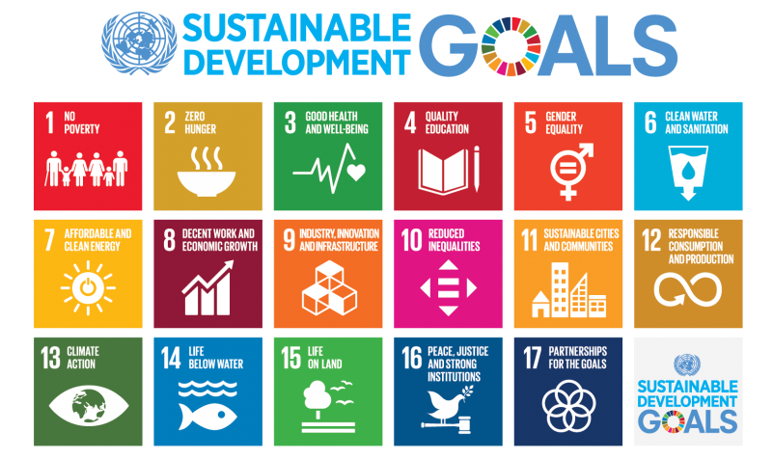
Notes:
Teacher notes:
The United Nations published 17 Sustainable Development Goals back in 2015
Businesses all over the world are using them as an easily understood and communicable framework and adopting their own objectives and targets aligned with the themes of the SDGs
The 17 SDGs provide a shared blueprint for peace and prosperity for people and the planet, now and into the future as well as an approach for companies and governments to frame sustainability issues.
Suggestion for discussion would be to ask the class to provide an example of each one and what they think it might refer to.
https://sdgs.un.org/goals - you can refer to these individually
https://www.youtube.com/watch?v=0XTBYMfZyrM

Slide 36
Exploring the SDGs
What one has your form decided to choose?
______________
What are the SDGs?
The SDGs (Sustainable Development Goals) are 17 global goals set by the United Nations to promote peace, prosperity, and environmental protection for all people by 2030.
When were they developed?
They were developed in 2015 and officially adopted by all UN member states.
Why have they been introduced?
They were introduced to end poverty, protect the planet, and ensure a sustainable future by addressing global challenges such as inequality, climate change, and environmental degradation.
Which ones link to Green Careers?
Green careers link to several SDGs, especially:
Goal 7: Affordable and Clean Energy
Goal 11: Sustainable Cities and Communities
Goal 12: Responsible Consumption and Production
Goal 13: Climate Action
Goal 15: Life on Land
5) Choose one and explain how the school could implement this.
Goal 13 – Climate Action:
The school could reduce its carbon footprint by starting recycling programs, using renewable energy sources, planting trees, and teaching students about sustainability and environmental care in lessons and projects.

Slide 37
Part 2: Green jobs and skills

Slide 38
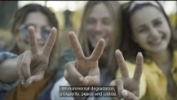
Green Careers in the UK
Notes:
https://youtu.be/U3tKINrlLhQ

Slide 39
Green Skills
Refers to the technical skills, knowledge, behaviours, and capabilities required to directly and indirectly tackle the environmental challenges we face and unlock new opportunities for growth​.
Technical knowledge for green jobs is the specialized understanding and practical skills needed to work with sustainable technologies, environmental systems, and renewable resources.
Transferable skills for green jobs are abilities that can be used across many different roles and industries. They help workers adapt, solve problems, and work effectively in sustainability-focused careers.
Technical knowledge:
Specialised and specific
Transferable skills:
Skills that can be applied across a wide range of jobs
Notes:
Teacher notes:
Highlight the difference between more technical and transferable skills.
Exercise: can students think of more examples for each box for different jobs?

Slide 40
Green Skills
Refers to the technical skills, knowledge, behaviours, and capabilities required to directly and indirectly tackle the environmental challenges we face and unlock new opportunities for growth​.
Technical knowledge:
  Specialised and specific
  Often required to perform certain tasks or jobs
  Often learnt through formal study or training but can also be learnt on the job
  Examples: understanding of health and safety, environmental auditing, tree harvesting or installing an electric vehicle charge point.
Transferable skills:
  Skills that can be applied across a wide range of jobs
  Often referred to as soft skills or employability skills
  Can be applied through formal study and training but are often developed throughout a career
  Examples include strategic thinking, project management, decision-making, leadership, and effective communication.
Notes:
Teacher notes:
Highlight the difference between more technical and transferable skills.
Exercise: can students think of more examples for each box for different jobs?

Slide 41
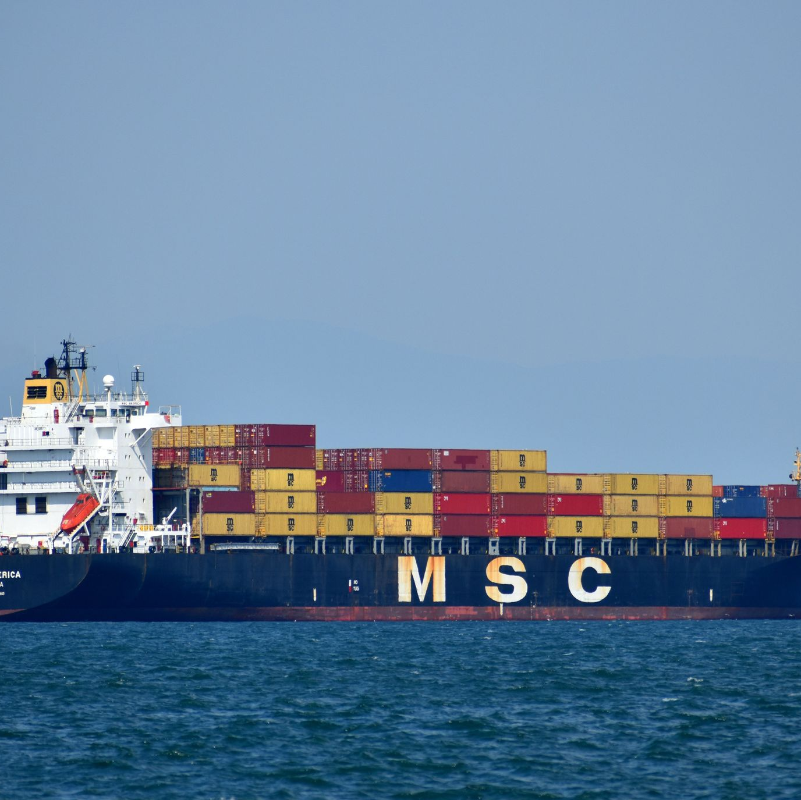
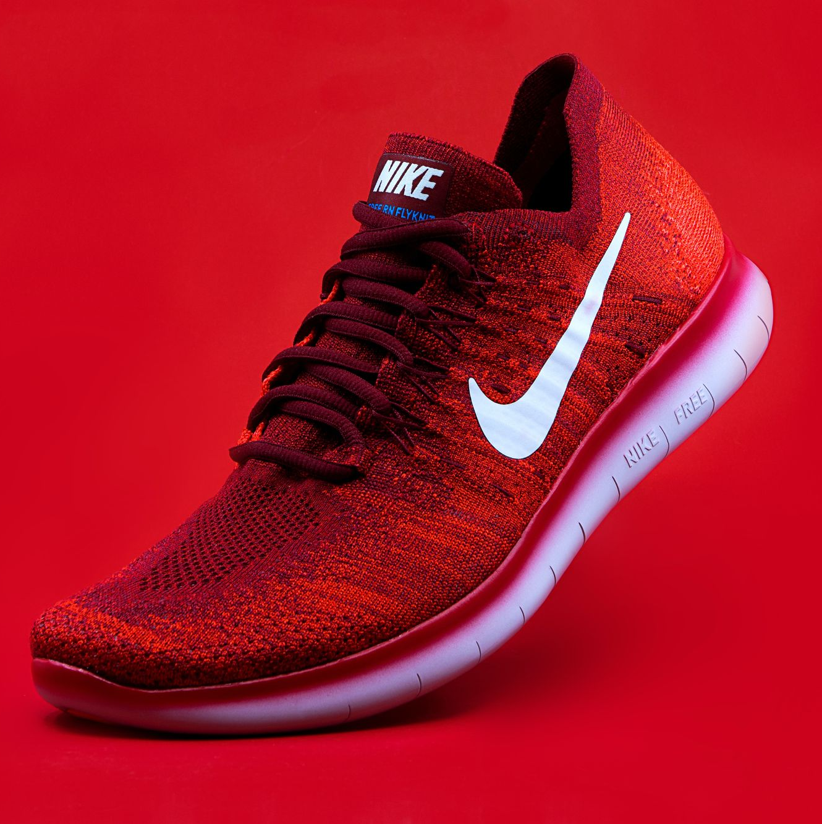
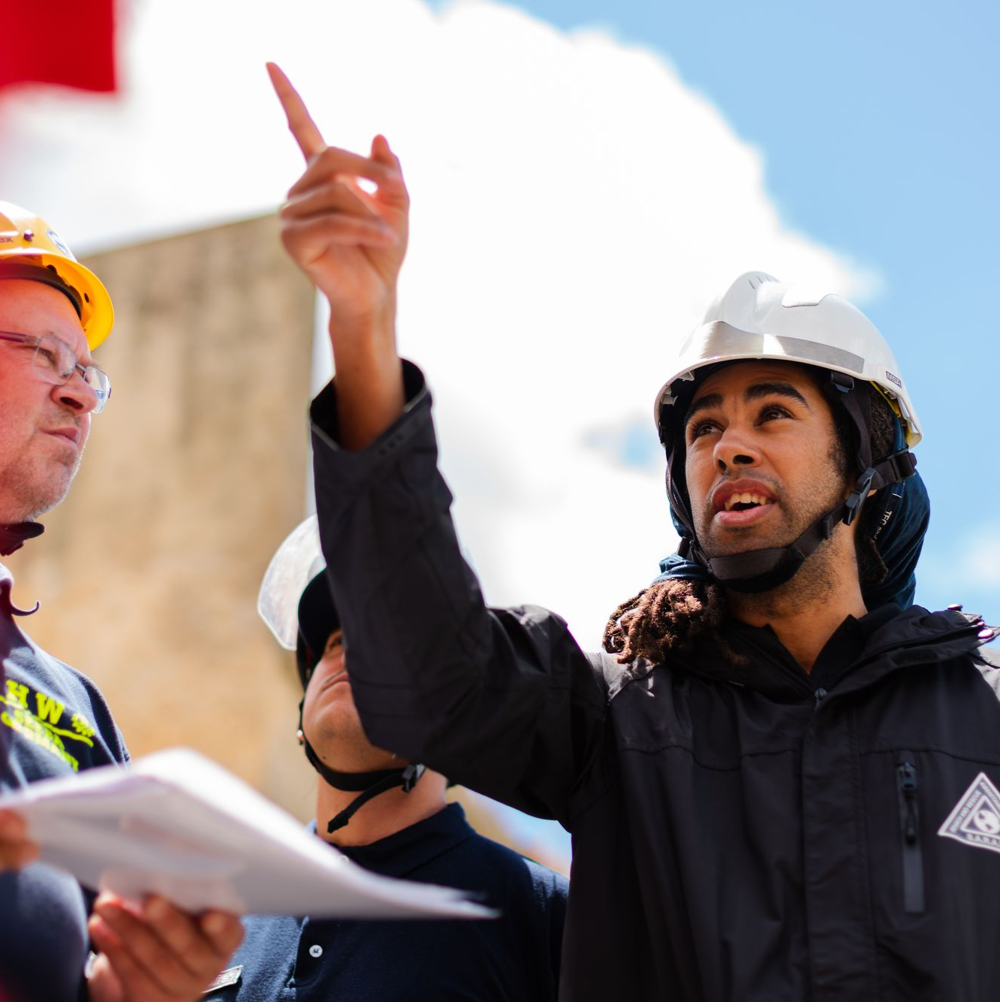
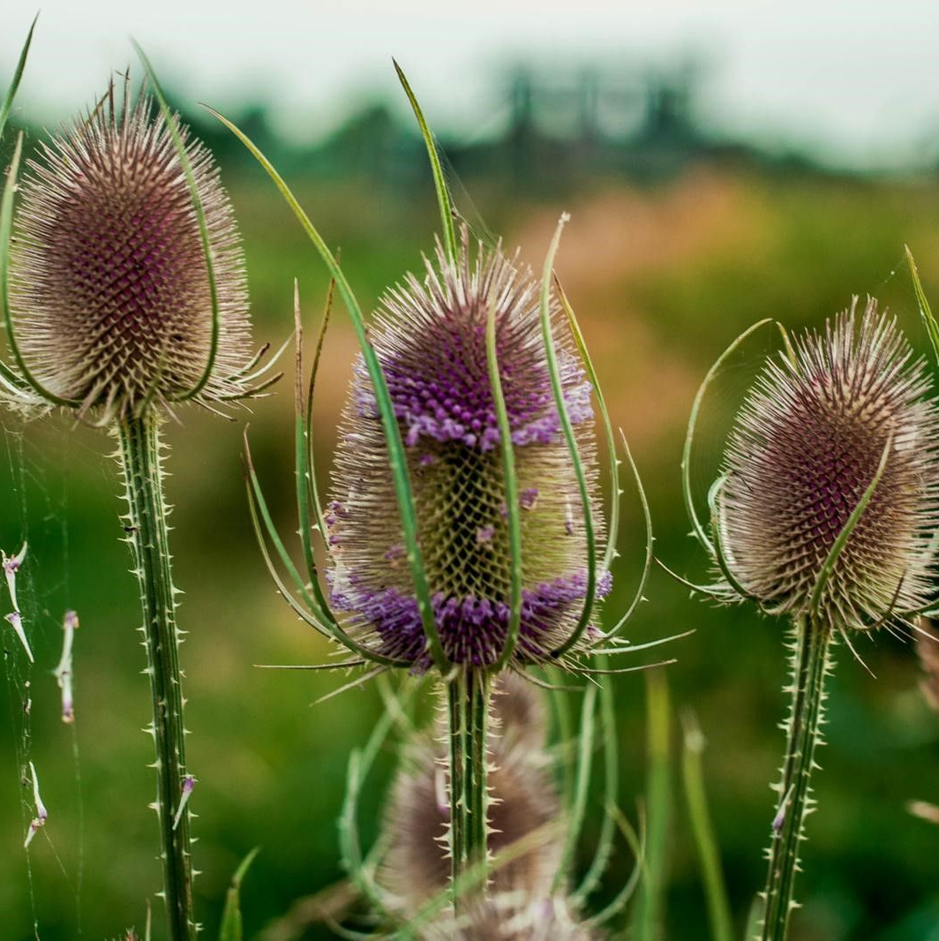
Examples of typical green jobs
Sustainable Procurement Manager
Eco-design Engineer
Ensuring that the purchase of goods and services takes sustainability into account
Considering environmental factors in design of products e.g. material choices
Sustainability Advisor/Consultant
Biodiversity Officer
Helping to protect and enhance nature and wildlife through surveys of habitats and species
Audits / inspections to ensure actions a in accordance with corporate sustainability policies
Notes:
Teacher notes:
The purpose of this slide is to highlight some typical green jobs that clearly relate to the environment by their job title. It’s aimed at showing the different types of roles out there and how they can relate to different subjects..
A Sustainable procurement manager will consider issues like ‘traceability’ through supply chains – e.g. to ensure no illegal deforestation
An eco-design engineer will look at how a product is manufactured or used by consumers, and think about more environmentally-friendly materials and packaging choices. For example, an ethical graphic designer will create branding with eco-friendly messaging.
An Environmental or Sustainability Consultant is influential in embedding responsible and sustainable business principles and practices with their clients and within their own organisations. They help ensure compliance with environmental laws and regulations. The primary purpose of the role of an Environmental Consultant is to assess and evaluate the impact and environmental impact likely to result from a specific project/product/activity or service/development.
A Biodiversity Officer acts as a consultee on biodiversity matters and will lead on the delivery of relevant initiatives to drive sustainable practices. They will need to communicate with numerous stakeholders to provide advice and guidance on ecological matters.

Slide 42
Can you tell me how these jobs will use green careers?
Electricians
Designers
Lawyers
An events organiser
Scientists
Notes:
Teacher notes:
Compared to the other slide, this is about highlighting 5 roles that people might not realise relate to the green agenda, but shows that you can still bring the passion for the environment into any role.

Slide 43
More examples you might not think about
Electricians are responsible for installing electric vehicle charge points.
Designers need to think about the materials they use – thinking about the circular economy.
Lawyers might want to specialise in environmental law – working on the frameworks responsible for protecting our planet.
An events organiser will need to think about how they can make events more sustainable e.g. considering areas such as packaging, staging materials and visitor travel.
Scientists are continuously researching and testing new materials and solutions for climate change.
Notes:
Teacher notes:
Compared to the other slide, this is about highlighting 5 roles that people might not realise relate to the green agenda, but shows that you can still bring the passion for the environment into any role.

Slide 44



Every job needs to be a green job
Marketing
Food & drink
Sport
Materials
Story telling & messaging
Methods of communication
Events
Ingredients
Food waste
Energy use
Working local
Events
Transport
Advertising
Materials
Food & drink
Notes:
Teacher notes:
We believe that every job needs to be a green job – if every person thinks about how they can make a difference, collectively we will make change.
Here are some examples of how green thinking can be brought into different roles. Each column gives key examples, which are outlined further here:
Marketing:
What materials are used for publicity e.g. are you using paper flyers and can they be recycled.
What’s the carbon footprint of the emails that you send – can you reduce the number sent?
Can you incorporate green messaging into your advertising, or on your websites.
Can your website use less carbon?
Are you sending out communications or materials that aren’t read?
Do you use marketing materials or freebies at events, are these plastic?
How do you encourage people to travel to your events?
Food & drink
Where does the food waste go from a restaurant?
Are you cooking with seasonal produce?
How do employees travel to the restaurant?
How often do you print menus, and are they recyclable?
Are you cooking with less carbon-intensive foods such as reducing the air miles or use of meat and dairy products.
What takeaway cartons and cups do you use?
Sport:
How do you encourage people to travel to your events?
Are sporting events
Who sponsors your sports team and are they environmentally-conscious?
Use of single-use plastic at sports events
Where does food waste from sporting events go?
Are your adverts used as a one-off?
Is there any pop-up materials that are used for each event?
How do players travel internationally?
Do you have vegetarian or vegan options for food at matches?

Slide 45
Activity: Greening a job
In your groups, choose one of the jobs below and think about how they could be greener, or incorporate sustainability.
  Local town mayor
  World top 10 tennis player
  Scientist
  Electrician
  Chef
  Construction worker
  Organiser of large events
  Politician
  Fashion designer
  Musician
  Owner of an online IT business
  Influencer
Working in groups of 4-6, use the paper to write out your ideas, thinking about the skills required, who they work with, and the types of projects they might be involved with.
Notes:
Teacher notes:
Examples for each role:
Look at putting in place more cycle lanes and recycling points/education
How they travel to events, the clothes that they wear, the brands they associate themselves with
Use of plastic materials, researching new materials or innovative technologies that can help with some of our climate/nature problems
Upskilling to be able to install electric vehicle charge points
Using seasonal produce and reducing food waste
Materials that they use, pollution from construction sites, how they travel to work
Sponsorship from sustainable brands, reducing single-use plastic at events, ensuring it’s held somewhere that is accessible by public transport, digital promotion
Changing policies around green development and practices, speaking to local communities
Creating clothes that will last a long time, thinking about who and how they fabrics are being made, the type of materials used
Generating energy from big concerts (like coldplay), thinking about the materials used for a big concert, how can people travel there, how do you promote
Reducing digital carbon impact, having a sustainability strategy in place, encouraging hybrid working (with less travel for staff)
Influencing for sustainable brands and products, showcasing things like cycling and using public transport

Slide 46
Activity: Greening a job
Electrical charging points for cars placed around the area
Creation of green spaces, such as parks and woodlands
Cycle lanes for sustainable forms of transport
Green Job Chosen:
Town Mayor
Protection of green belt land
Net zero housing using solar and wind energy
Sustainable forms of energy placed in the area
Notes:
Teacher notes:
Examples for each role:
Look at putting in place more cycle lanes and recycling points/education
How they travel to events, the clothes that they wear, the brands they associate themselves with
Use of plastic materials, researching new materials or innovative technologies that can help with some of our climate/nature problems
Upskilling to be able to install electric vehicle charge points
Using seasonal produce and reducing food waste
Materials that they use, pollution from construction sites, how they travel to work
Sponsorship from sustainable brands, reducing single-use plastic at events, ensuring it’s held somewhere that is accessible by public transport, digital promotion
Changing policies around green development and practices, speaking to local communities
Creating clothes that will last a long time, thinking about who and how they fabrics are being made, the type of materials used
Generating energy from big concerts (like coldplay), thinking about the materials used for a big concert, how can people travel there, how do you promote
Reducing digital carbon impact, having a sustainability strategy in place, encouraging hybrid working (with less travel for staff)
Influencing for sustainable brands and products, showcasing things like cycling and using public transport

Slide 47
Activity: Lets do one together
Green Job Chosen:
_________________________
Notes:
Teacher notes:
Examples for each role:
Look at putting in place more cycle lanes and recycling points/education
How they travel to events, the clothes that they wear, the brands they associate themselves with
Use of plastic materials, researching new materials or innovative technologies that can help with some of our climate/nature problems
Upskilling to be able to install electric vehicle charge points
Using seasonal produce and reducing food waste
Materials that they use, pollution from construction sites, how they travel to work
Sponsorship from sustainable brands, reducing single-use plastic at events, ensuring it’s held somewhere that is accessible by public transport, digital promotion
Changing policies around green development and practices, speaking to local communities
Creating clothes that will last a long time, thinking about who and how they fabrics are being made, the type of materials used
Generating energy from big concerts (like coldplay), thinking about the materials used for a big concert, how can people travel there, how do you promote
Reducing digital carbon impact, having a sustainability strategy in place, encouraging hybrid working (with less travel for staff)
Influencing for sustainable brands and products, showcasing things like cycling and using public transport

Slide 48
Sustainability cuts across all subject areas
Sport
Sciences
Art
Geography
Social studies
Maths
Notes:
Teacher notes:
Sport – thinking about how people can accessibly travel to sports events. Who are the advertisers at matches and what are they promoting? Reducing plastic waste through the use of reusable cups at events. Working with local communities when building new stadiums.
Sciences – researching new technologies that can be used to help us reduce the impacts of climate change, or creating new materials that can be used instead of plastics
Art – designing
Geography – town planning, tracking rivers, erosion etc., which all gives us vital data
History – understanding societies today and how we can support them to move to a green transition
Maths – construction and engineering roles, or sustainable finance and data analysis will use maths skills

Slide 49

Career Entry Routes
Further research
University degrees
Example courses:
BSc Environmental Health
BSc (Hons) Environmental Science
BSc Sustainability and Environmental Management
BA Hons Environment and Planning
Other subjects such as business, finance and construction could also feature elements of sustainability. Search the UCAS website for more info!
View the Apprenticeships page on the Green Careers Hub:
Apprenticeships
Example courses:
Environmental Practitioner Degree – Level 6
Corporate Responsibility and Sustainability Practitioner - Level 4
Countryside worker – Level 2
Low Carbon Heating Technician - Level 3
Volunteering
Notes:
Teacher notes:
The purpose of this slide is to explain that there are lots of different routes into working in sustainability
There is a list of green apprenticeships online for England, available through IFATE:
Or there are also a number of relevant university degrees, at undergrad or postgrad level - from BioInnovation to Environmental Management, or Marine Management, or Carbon Management – some at undergraduate and others at postgraduate. We’d recommend searching the courses on UCAS
You can also career change and train later on in your career – many people realise they want to work in this sector after doing something different
There are many ways in which volunteering can support the green agenda. In fact, environmental organisations often rely on volunteers to fulfil certain tasks e.g. picking litter from green spaces, protecting local wildlife, local charity shops. Useful information on volunteering can be found on the Green Careers Hub, as well as some organisations that might look for volunteers: https://www.greencareershub.com/developing-your-career/practical-experience/volunteering/

Slide 50
Part 3: The Green Careers Hub

Slide 51
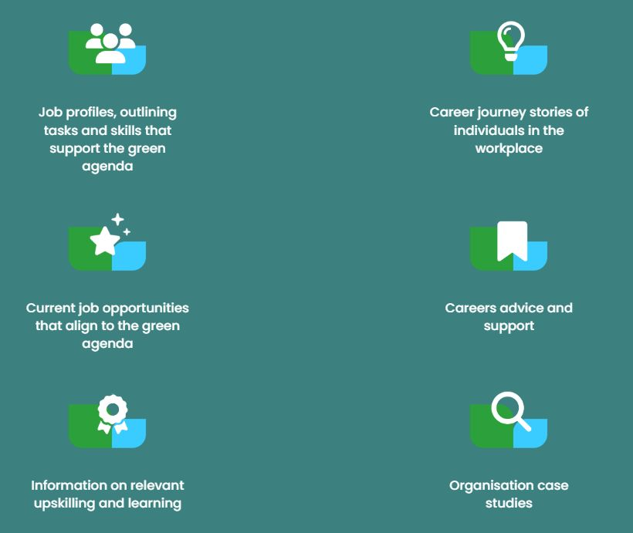
What is the Green Careers Hub?
A website designed to showcase information and resources about green jobs, skills and careers
The mission is a world in which all jobs are greener.
Notes:
Teacher notes:
The Green Careers Hub is a website that anyone can view to get more information about different green jobs and skills.
To get to a future where we’re living and working sustainably, we believe that every single job needs to be greener.
Without green skills and jobs we will not meet our net zero and wider environmental goals. Working in collaboration with numerous partners, ISEP developed the Green Careers Hub as a one-stop shop for information on green skills and jobs.
The mission of the Hub is to promote a more sustainable future by providing access to information and opportunity around green skills, jobs and careers. The platform is designed to be a space where anybody, from any sector or background, can go to understand how they can play a role in the wider green agenda.
The most relevant sections for your audiences are:
Sector pages: https://www.greencareershub.com/green-future/green-economy/
Video library: https://www.greencareershub.com/find-your-green-role/organisation-case-studies/
Case studies: https://www.greencareershub.com/find-your-green-role/career-stories/
Partner case studies: https://www.greencareershub.com/find-your-green-role/partner-career-stories/
Learning: https://www.greencareershub.com/developing-your-career/learning/
Practical experience: https://www.greencareershub.com/developing-your-career/practical-experience/
Webinar recording library: https://www.greencareershub.com/developing-your-career/careers-events/
Please note, the majority of the content is not written for an under 18s audience, so it is more useful for teachers and careers leaders.

Slide 52
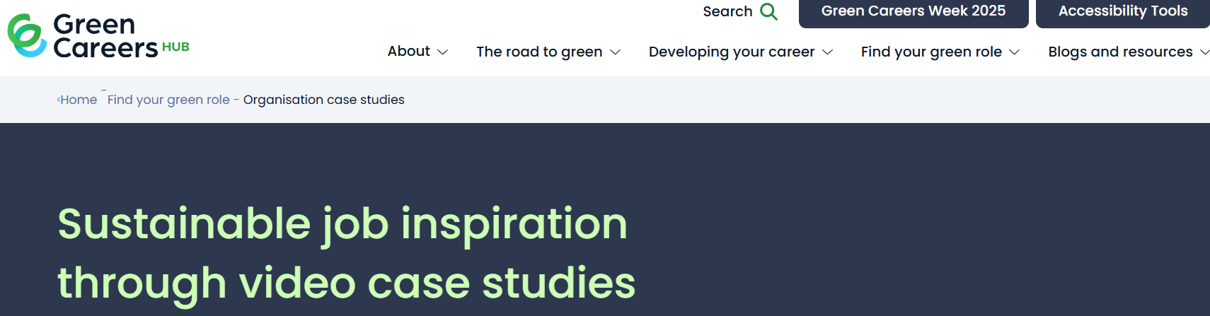
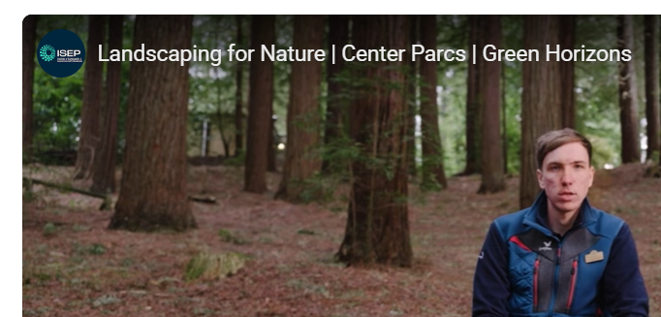
Green Career Case Study
Write about one job on the video library on the Green Careers Hub website. Choose the career job together and add details on the job to your work booklet.
Notes:
Log on the Video library: https://www.greencareershub.com/find-your-green-role/organisation-case-studies/ and choose a case study to watch with the students. The student writes a job description based on the video.

Slide 53
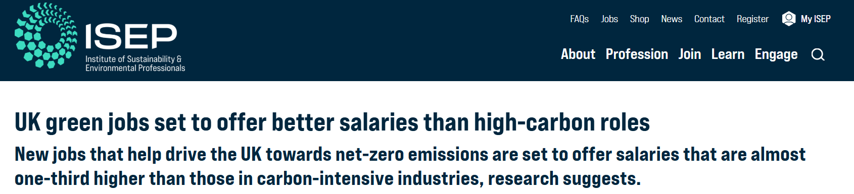
Read together and complete page 13 of your work booklet
What are your thoughts on the piece?
Would you consider a net zero job or a green career for the future?
What industry would you go into?
Notes:
Read together with the tutor group: https://www.isepglobal.org/articles/uk-green-jobs-set-to-offer-better-salaries-than-high-carbon-roles?t=156573

Slide 54




Benefits of a green job: Add to page 13
Sense of purpose
Growing demand
Supporting the planet for future generations
Playing your part in the future green economy
According to LinkedIn, “Job seekers with green skills or titles see a 54.6% higher hiring rate than the workforce overall”
Variety of roles
Higher salaries
Flexibility
Jobs across the whole of the UK
Technical and academic routes
Research shows that green jobs see strong salary growth
A report in 2025 showed that the average annual wage was higher in net zero businesses.
Notes:
Teacher notes: aim of this slide is to encourage individuals to consider a green job, by showing the benefits it can have
Resources:
https://www.theguardian.com/environment/2025/feb/24/britain-net-zero-economy-booming-cbi-green-sector-jobs-energy-security
https://www.isepglobal.org/articles/uk-green-jobs-set-to-offer-better-salaries-than-high-carbon-roles?t=156573
https://www.hays.co.uk/market-insights/article/top-10-sustainability-salary-increases

Slide 55
Job spotlight: ________________
As a form class, choose one of the four Green Job spotlights in the next few slides and complete a spotlight on the job giving the following areas: routes to entry, example task and average salary.
Routes to entry:
Example tasks:
Average salary:
Notes:
Teacher notes:
Reforestation is a key solution to the climate crisis. Trees play an important part in protecting our biodiversity and animal habitats, and can enhance our ecology. They are vital to our mental and physical well-being and support a low carbon economy by naturally absorbing and storing carbon.
Sustainable forest management is the responsibility of ensuring that woodland and forest areas are protected and sustained through the practical application of considered and careful forestry activities. It also involves enabling and addressing the correct social, environmental and economic balance for the future health and maintenance of the forest.
Can see more detail on different apprenticeship routes across the various devolved nations at https://www.lantra.co.uk/careers/JobProfile/JobProfileDetails/66
Examples of companies that would hire these roles:
Charities and not for profits
Forestry Commission ( a non-ministerial government department) or potentially local authorities, or Forestry England
Estates
Tree surgeon organisations
Businesses contracted for woodlands

Slide 56
Job spotlight: Forestry Worker
Note: information taken from the Lantra careers website: https://www.lantra.co.uk/careers/JobProfile/JobProfileDetails/66
Routes to entry:
T Level / Level 1 or 2 course
an apprenticeship
volunteering
applying directly
Example tasks:
clear undergrowth and cut down trees
plant tree seedlings
put up fences, gates and public notices
maintain equipment, drainage systems and car parks
protect the forest from pests
Average salary: £18.5k - £25k per year
Notes:
Teacher notes:
Reforestation is a key solution to the climate crisis. Trees play an important part in protecting our biodiversity and animal habitats, and can enhance our ecology. They are vital to our mental and physical well-being and support a low carbon economy by naturally absorbing and storing carbon.
Sustainable forest management is the responsibility of ensuring that woodland and forest areas are protected and sustained through the practical application of considered and careful forestry activities. It also involves enabling and addressing the correct social, environmental and economic balance for the future health and maintenance of the forest.
Can see more detail on different apprenticeship routes across the various devolved nations at https://www.lantra.co.uk/careers/JobProfile/JobProfileDetails/66
Examples of companies that would hire these roles:
Charities and not for profits
Forestry Commission ( a non-ministerial government department) or potentially local authorities, or Forestry England
Estates
Tree surgeon organisations
Businesses contracted for woodlands

Slide 57
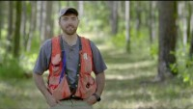
Notes:
https://www.youtube.com/watch?v=262YqU9VsUU

Slide 58
Job spotlight: Carbon Accountant
Note: information taken from: https://notjustlabcoats.co.uk/careers-hub/career-roles/role/carbon-accountant/#:~:text=Carbon%20Accountants%20measure%2C%20manage%2C%20and,data%20into%20clear%2C%20actionable%20insights.
Routes to entry:
A degree is desirable
Degree-level apprenticeships
Specific training courses
Example tasks:
Conducting daily data analysis
Researching new environmental, climate and business legislation
Writing reports to comply with relevant standards
Creating value chain maps
Attending project meetings
Average salary: £20k - £75k (in a senior role) per year
Notes:
Teacher notes:
Carbon accounting involves defining, quantifying, analysing and reporting on an organisation’s carbon footprint. This includes completing greenhouse gas calculations and offering advice on carbon reduction to businesses.
The role is desk-based for around 90% of the time, so it can be done remotely or in an office environment.
Career progression could include becoming a verifier, an energy consultant or senior carbon accountant.
Examples of companies that would hire these roles:
Any organisation (private or public sector)
Could be commercial or non-profit

Slide 59
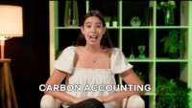
Notes:
https://www.youtube.com/watch?v=Ff5wWmxB73Y

Slide 60
Job spotlight: Electrician
Note: information taken from Electrical Contractors Association via the Green Careers Hub: https://www.greencareershub.com/find-your-green-role/job-profiles/electrician/
Routes to entry:
T-levels
full-time education
an apprenticeship
training / assessment
applying directly
Example tasks:
Install and maintain equipment / components, including green technologies such as solar panels, wind turbines, electric vehicles, heat pumps.
Use a range of tools and materials,
Plan and install domestic and/or commercial and industrial electrical and electronic systems
Inspect and test domestic installations
Average salary: £10k (apprenticeship) - £50k (experienced) per year
Notes:
Teacher notes:
An Electrician’s core skill set underpins several low carbon technologies and is highly transferable to emerging occupations supporting the sustainability agenda. A qualified Electrician has the knowledge and skills to safely install electric vehicle charge points (EVCPs), solar/PV panels and other low carbon technologies.
Other growth areas, such as smart buildings and the electrification of heat, can utilise the base skills of an Electrician, with additional and specialised upskilling.
Note different apprenticeship routes and entry points across the devolved nations. More information on the ECA website here: https://www.electricalcareers.co.uk/joining-the-industry/training-routes
Types of organisations:
Can be freelance
Smaller businesses
Or might be in-house electricians

Slide 61
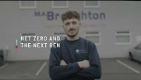
Notes:
https://www.youtube.com/watch?v=-ob2OJbBmKc&list=TLGGvhUJ2DVPDcwyMjEwMjAyNQ&t=2s

Slide 62
Job spotlight: Ecologist
Note: information taken from https://www.greencareershub.com/find-your-green-role/job-profiles/ecologist/
Routes to entry:
Degree-level study is typical
Apprenticeships or training courses
Work experience is valuable
Example tasks:
Fieldwork and surveys
Identification of plant species and animals
Working on habitat creation plans
Using technology to model the effects of changing environments and impacts
Average salary: £25k - £40k per year
Notes:
Teacher notes:
An Ecologist studies the relationship between animals and plants and the environment in which they live. Their work typically looks at the impact changes to the environment have on the distribution and abundance of different species and how we can manage those impacts to help nature thrive. A generalist Ecologist will have a broad understanding of lots of different species and habitats, but some Ecologists specialise in specific groups of species and habitats, such as mammals or the marine environment.
From starting as a junior Ecologist, your career journey could take different directions depending on the employment sector. Or, you could go from being an Assistant Ecological Consultant to becoming a Senior Ecologist and then a Principal Ecologist for a big private sector consultancy (or even setting up your own consultancy). Another option could involve becoming a local authority ecologist or working for a government department.
Types of organisations:
Consultancies
Nature-based/conservation charities
Construction businesses

Slide 63
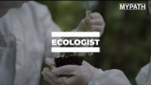
Notes:
https://www.youtube.com/watch?v=RMMzbuKNT_g

Slide 64

Green job myth-busters- Show me T or F
Green jobs are all spent working outdoors
2. There aren’t any green jobs in my area
3. You need a degree for a green job
4. I can’t use my existing skills for a green job
  FALSE – green jobs can be part-time, seasonal, office-based, traveling around sites or working outside.
  FALSE – there are jobs up and down the country, and new projects springing up all the time.
  FALSE – there are jobs at all levels.
  FALSE – there are many transferable skills that you can bring across from a previous role.
Notes:
Teacher notes: Get the students to use show T or F to the statements or thumbs up and thumbs down
Examples of projects that might impact hiring in green jobs:
New housing developments
New solar or wind farms
Freeports – which include hydrogen projects
New battery storage sites
New waste infrastructure
New networks coming together on green themes
Development of a new green qualification
Nature recovery programmes
Examples of transferable skills:
- Analytical thinking
Creativity
Critical thinking
Effective communication
Influencing
Innovating
Leadership
Listening
Management
Presenting
Prioritising
Relationship development
Resilience
Stakeholder engagement
Collaborating

Slide 65
Job spotlight: ________________
As a form class, choose one more case study and complete a job description. Complete this on page 15 of your work booklet. This could be a role your research later. Complete the discussion slide on your job you have chosen with your form tutor.
Routes to entry:
Example tasks:
Average salary:
Notes:
Teacher notes:
Reforestation is a key solution to the climate crisis. Trees play an important part in protecting our biodiversity and animal habitats, and can enhance our ecology. They are vital to our mental and physical well-being and support a low carbon economy by naturally absorbing and storing carbon.
Sustainable forest management is the responsibility of ensuring that woodland and forest areas are protected and sustained through the practical application of considered and careful forestry activities. It also involves enabling and addressing the correct social, environmental and economic balance for the future health and maintenance of the forest.
Can see more detail on different apprenticeship routes across the various devolved nations at https://www.lantra.co.uk/careers/JobProfile/JobProfileDetails/66
Examples of companies that would hire these roles:
Charities and not for profits
Forestry Commission ( a non-ministerial government department) or potentially local authorities, or Forestry England
Estates
Tree surgeon organisations
Businesses contracted for woodlands

Slide 66
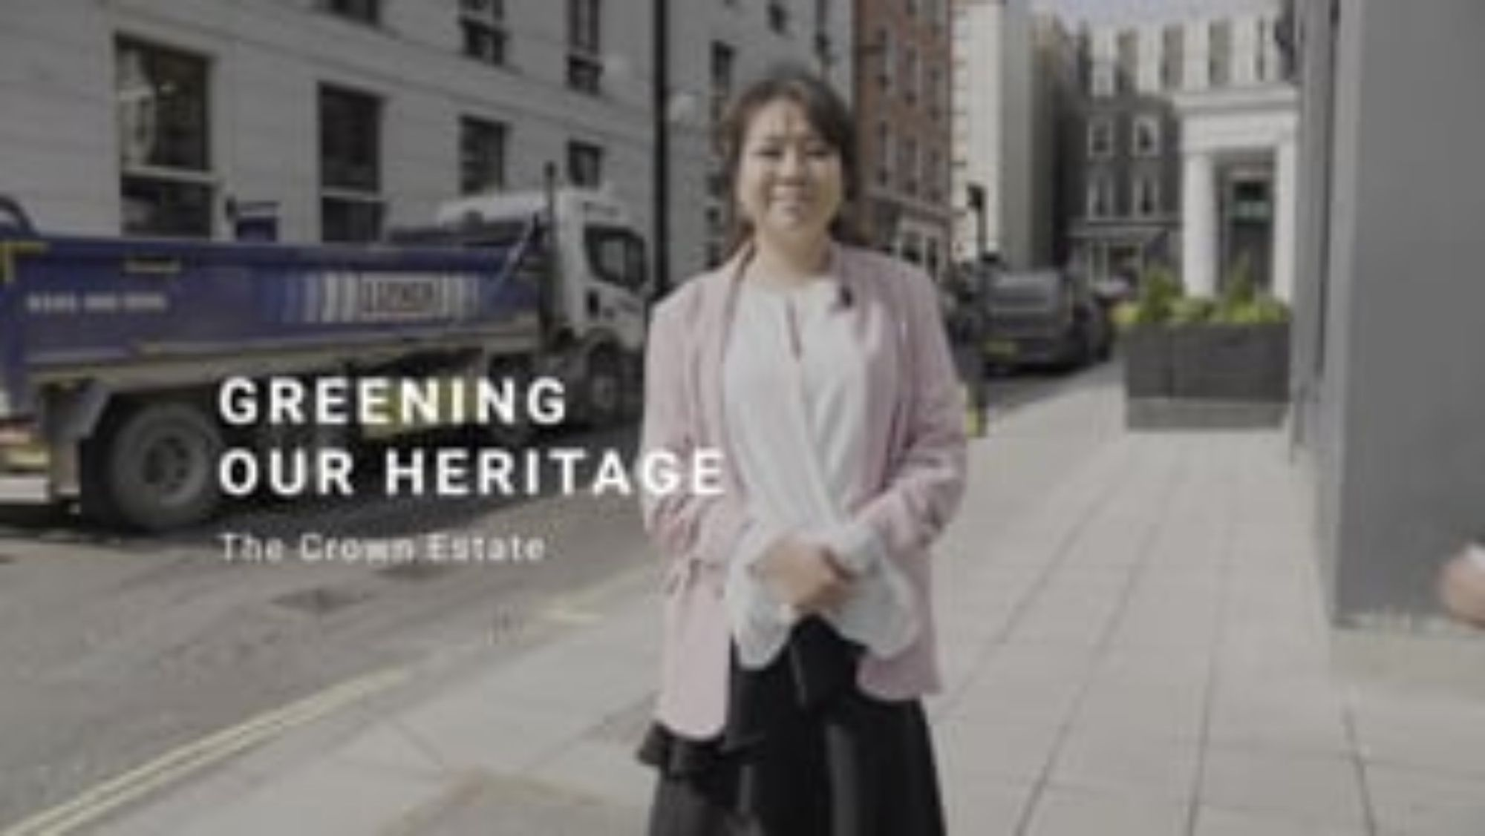
Notes:
Temple is a proud, independent SME. Purpose driven to make a meaningful environmental and social difference, it is a certified B Corporation, which means the organisation has been officially recognised as one that balances profit with people and the planet.
Harry Jarvis, who has a Master’s in Environment Management, joined Temple in 2021. Harry says he benefits from working at a company large enough to attract the sector’s best talent, but small enough to maintain a collegiate approach to its work.

Slide 67
Greening our heritage: discussion points
Can you think of any local heritage sites near you?
What do you think some of the challenges might be in restoring our historic buildings?
Does working in construction appeal to you, and if so, why?
What subjects at school might help lead to a role in construction, retrofit or restoration?
Notes:
Teacher notes:
Dependent on location
Examples:
Cost: the demand for repair, maintenance and retrofit work on pre-1919 buildings is estimated at around £28 bn per year. Lots of these buildings may be owned by not-for-profits or charities as well, where there is limited resource/funding
Having enough skilled workers that specialise in these types of building
Arguments for and against new build vs. retrofitting older buildings
Depending on the building, it might require special permissions to do certain work
Students’ perspective – ideas might include:
Get to work with interesting buildings that have been around for a very long time
Varied in terms of the buildings that you work with
More hands-on work
It’s very dependent on the role, but relevant subjects could include science-based subjects or maths, different certificates in various construction skills, level 5 qualification in retrofit coordination, construction higher nationals. Architecture or civil engineering degrees at university might be an option.

Slide 68
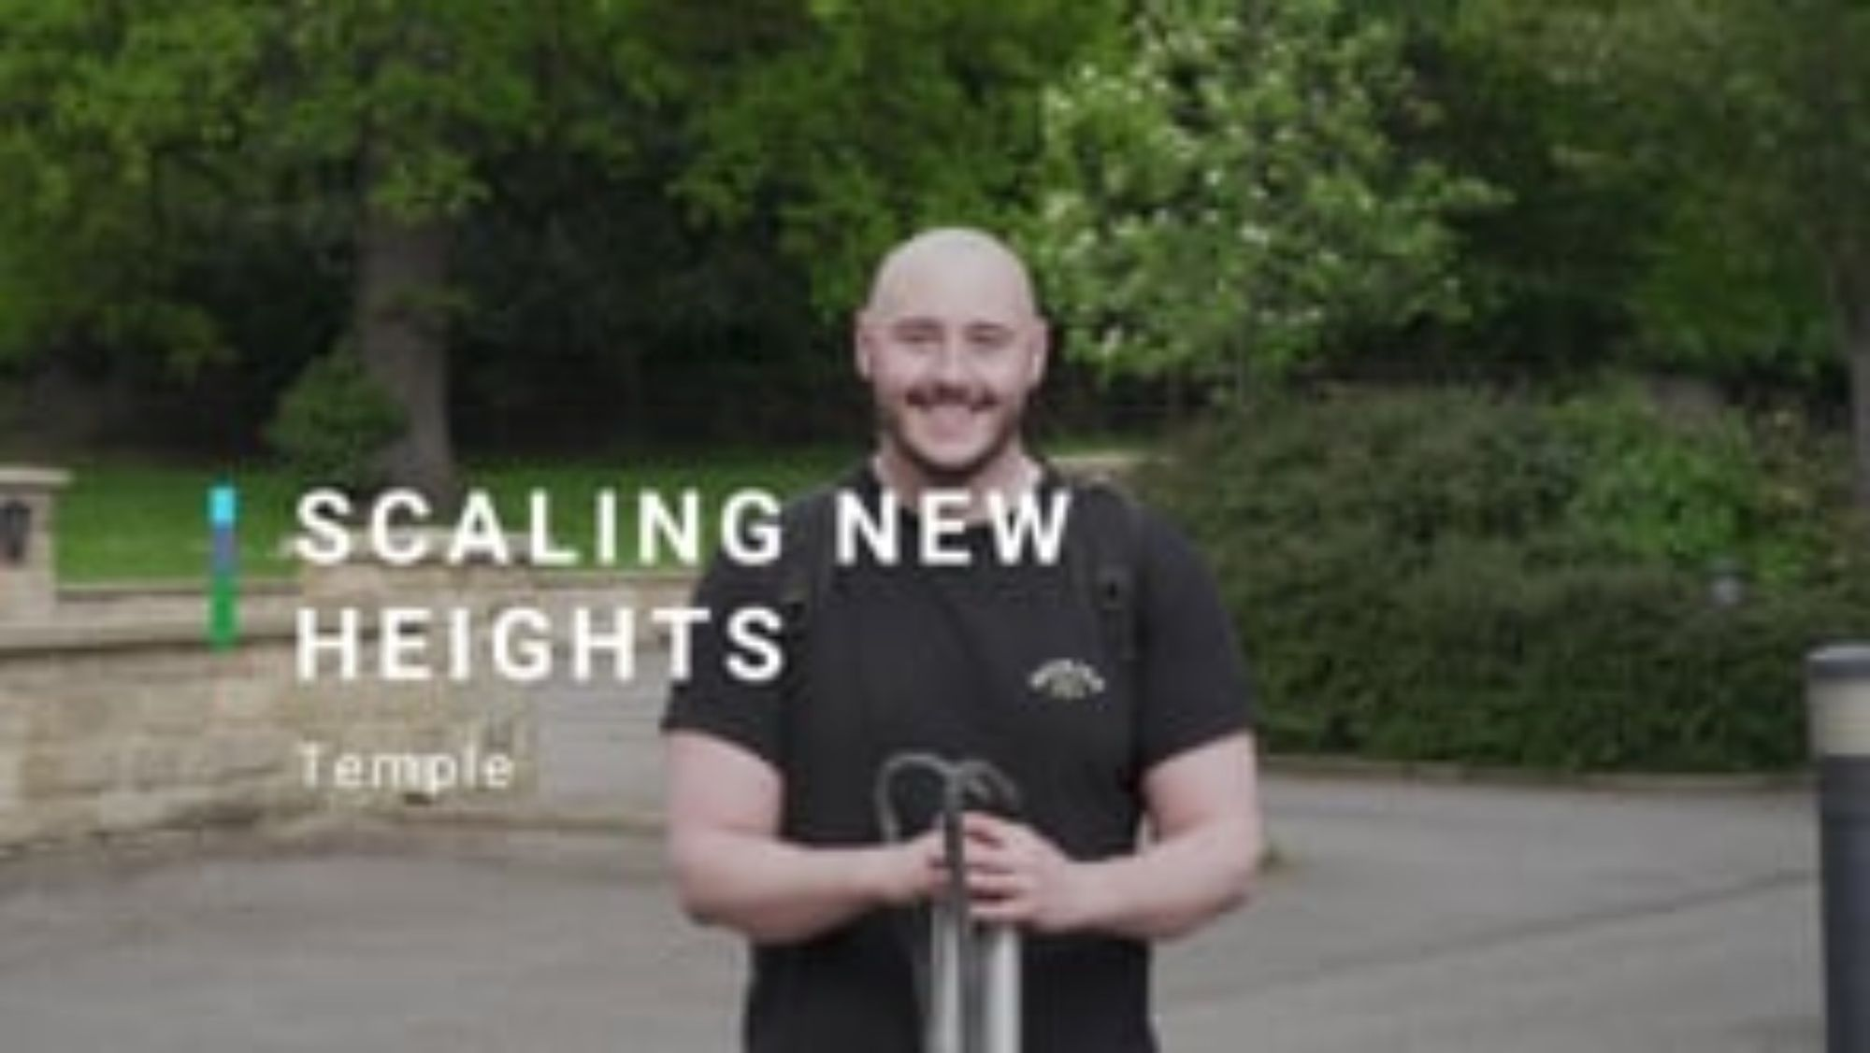
Notes:
Temple is a proud, independent SME. Purpose driven to make a meaningful environmental and social difference, it is a certified B Corporation, which means the organisation has been officially recognised as one that balances profit with people and the planet.
Harry Jarvis, who has a Master’s in Environment Management, joined Temple in 2021. Harry says he benefits from working at a company large enough to attract the sector’s best talent, but small enough to maintain a collegiate approach to its work.

Slide 69
Scaling new heights: discussion points
Harry mentions doing bat surveys in the video, why do you think this is important?
How might it differ to work in a small vs. larger organisation?
Does this role appeal to you, and if so, why?
What subjects at school might help lead to a role as an Ecologist?
Notes:
Teacher notes:
Ideas may include:
Understand how bat behaviour changes over time
Bats are important to our ecosystem because they pollinate and also help to control insect numbers. They also disperse seeds to help maintain forests or healthy plant communities
Therefore if there are bats living in certain places, you may not be able to build there or disturb the family
Small org: exposure across the business and working with people at different levels / Larger: might be more opportunities to progress up the career ladder, or try different teams and roles. Lots of colleagues for support
Students’ perspective – ideas might include:
Climbing trees
Working with animals
Working with nature
Smaller team to work with
Relevant subjects could include biology, geography, other science subjects, maths, environmental science. You can study some of the following courses at university: ecology, conservation, marine or plant biology, environmental science or zoology. There are also lots of relevant apprenticeships available.

Slide 70
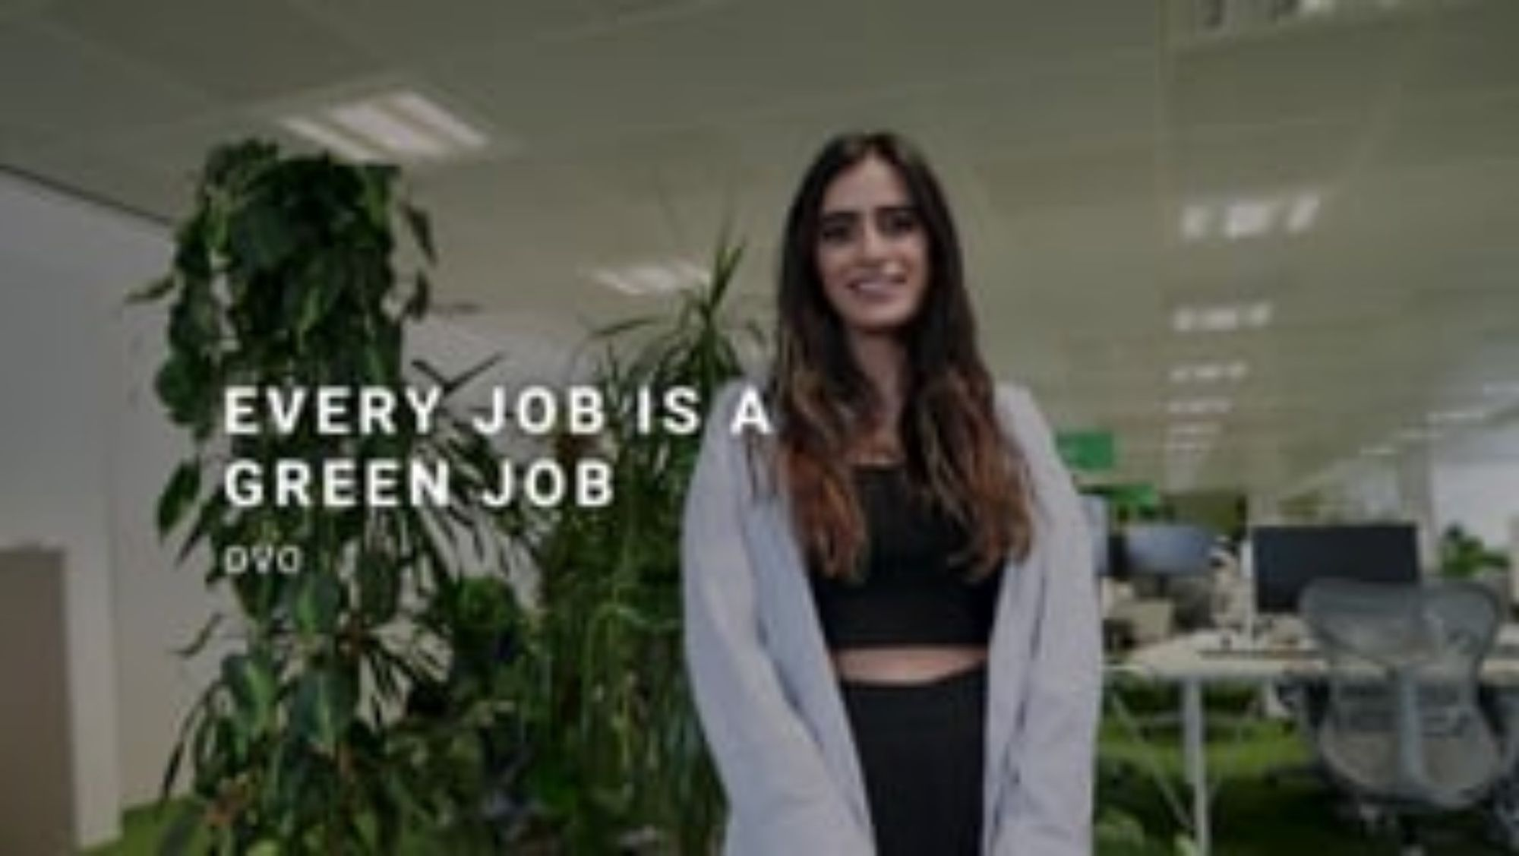
Notes:
Launched in 2009, OVO is an energy supplier on a journey to zero carbon, helping to make energy cheaper, greener and simpler for more than a million members.
Reena Dosanjh is a Senior Product Marketing Manager at OVO Energy in Bristol. A storyteller, with a degree in Journalism, Media and Cultural Studies, Reena uses her marketing skills to communicate with OVO Energy’s stakeholders and customers about the company’s green products and services.

Slide 71
Every job is a green job: discussion points
Why might an initiative like Plan Zero be helpful to a business?
What other green jobs might exist at a company like Ovo Energy?
As well as purpose, what other factors can impact your decision on what type of organisation or role you’d like to do in the future?
Does this role appeal to you, and if so, why?
What subjects at school might help lead to a role in marketing?
Notes:
Teacher notes:
Provides a framework and targets to work towards on their own carbon bring, unites employees in a common goal, good for brand reputation and supports local communities, upskills employees and customers
Sustainability team, engineers, electricians, legal team, energy assessors, data analysts, designers,
Salary, location, career progression, support to further your learning (e.g. training)
Students’ perspective – ideas might include:
Can be creative
But might also require technical skills
Work with lots of teams across the business
Can involve event organisation
Lots of different roles across marketing, including at entry level
Very up to date with what the organisation is doing
This could be very varied, but relevant subjects could include business studies, as well as art/design, English language and English literature

Slide 72
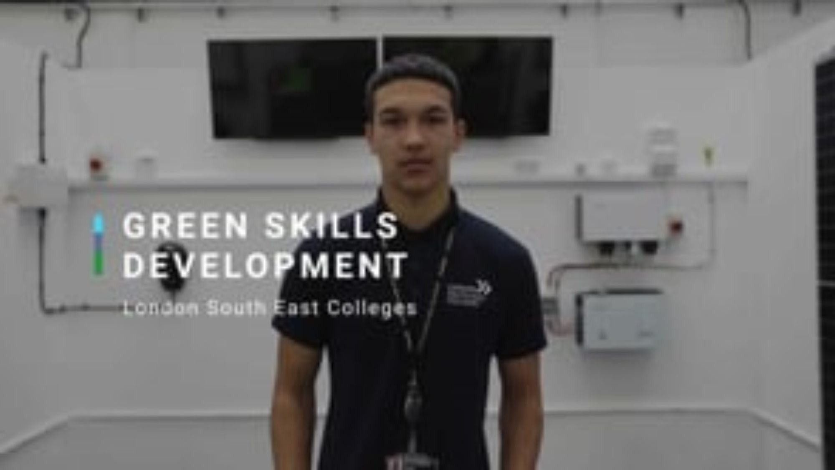
Notes:
Comprising over 20 education providers, 9 local authorities and over 30 employers, the Local London Green Jobs and Skills Partnership aims to influence and shape green employment and skills provision, drive job creation and secure high-quality green and digital skills training.
19-year-old student Daniel Hayden is one of the first Londoners to take advantage of a new training space designed for the next generation to gain the skills required for the green economy. Daniel, a Level 2 student, aspires to one day start his own electrical business.

Slide 73
Green skills development: discussion points
How does the role of electrician support a better planet for the future?
What transferable skills do you think are needed as an Electrician?
Does this role appeal to you, and if so, why?
What are the advantages and disadvantages of starting your own business?
Notes:
Teachers notes:
An Electrician’s core skill set underpins several low carbon technologies and is highly transferable to emerging occupations supporting the sustainability agenda. A qualified Electrician has the knowledge and skills to safely install electric vehicle charge points (EVCPs), solar/PV panels and other low carbon technologies.
Time management, Planning, Organising, Writing, Problem reframing and resolution, Customer service, Effective communication
Students’ perspective – ideas might include:
Hands-on and practical
Learn a life-long skill
Get to work for different types of organisations and therefore different settings
Can do apprenticeships so earn and learn at the same time
Advantages: be your own boss and really invest into the business, flexibility, rewarding to see your business succeed, job satisfaction. Disadvantages: less steady or secure income stream (financial instability), higher stress as you are more invester, can be difficult to find work, hours can vary and can often be long, might feel isolated
You can search for green apprenticeships in the UK from links on this page: https://www.greencareershub.com/developing-your-career/practical-experience/apprenticeships/
You can search for green skills bootcamps in England at: https://www.skillsforcareers.education.gov.uk/pages/training-choice/skills-bootcamp
The following pages on the Green Careers Hub may also be useful:
https://www.greencareershub.com/developing-your-career/learning/education/
https://www.greencareershub.com/developing-your-career/learning/finding-your-way-to-a-green-future/

Slide 74
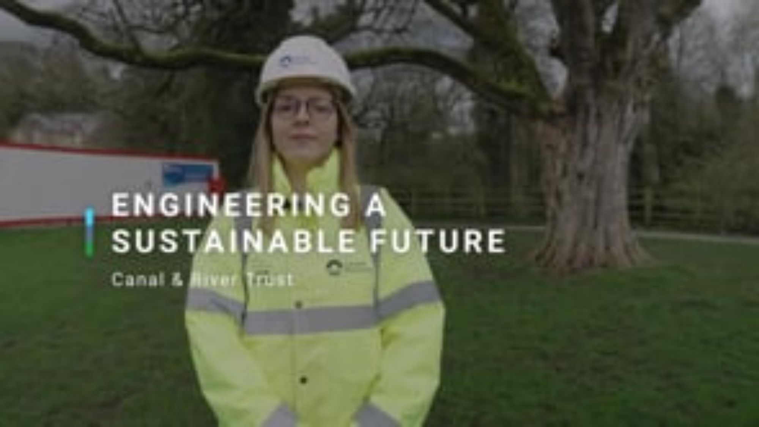
Notes:
The Canal & River Trust is a charity that cares for a 2,000-mile-long, 200-year-old network of canals, rivers, reservoirs, docks and attractions across England and Wales.
For Senior Engineer Helen Braidwood, working at the Canal & River Trust means prioritising sustainability in every project she’s involved with. That’s combining traditional civil engineering with skills like ecology, carbon management, energy efficiency and water conservation

Slide 75
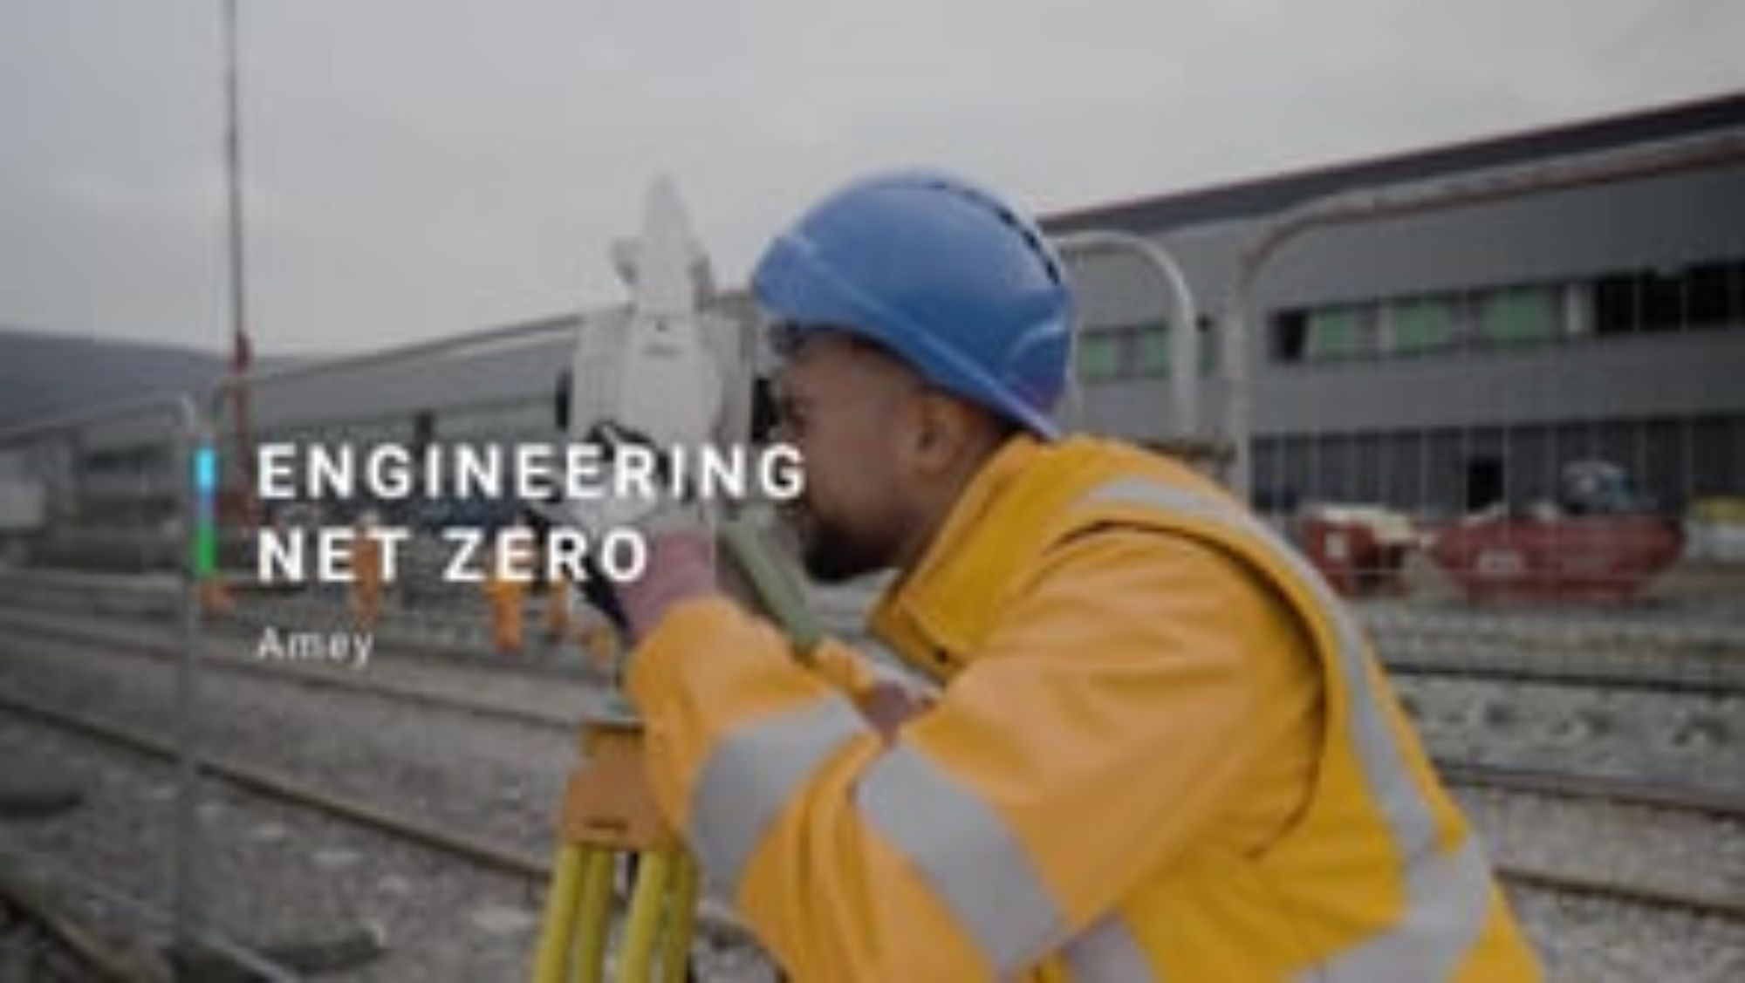
Notes:
Amey is the leading provider of full life cycle engineering, operations and decarbonisation solutions for transport infrastructure and complex facilities.
Omar Alkarnez, a graduate Civil Engineer, has worked at Amey for a year. He’s already making his mark and gaining vital experience by working on the Core Valley Line project, a major infrastructure project providing faster, more efficient and greener transport in South Wales.

Slide 76
Engineering a sustainable future and Engineering net zero: discussion points
Why is an electrically charged fleet of trams better for the planet than the diesel engines?
How might the team at Canal & River Trust need to think about wildlife in the area?
What do you think are some of the environmental impacts that might need to be considered for either of these projects?
Does this role appeal to you, and if so, why?
Has anything about civil engineering surprised you?
What subjects at school might help lead to a role in Civil Engineering?
Notes:
Teacher notes:
Electricity produces fewer Co2 emissions and can be charged with renewable energy. However, it is also important to note that electric vehicle batteries can be difficult to dispose of, which can create additional environmental impacts.
Are there any protected species that are living in the area and how might the work disrupt their habitat? Will any potential pollution impact the ecosystem?
Pollution from their construction work - where does it go? The materials that they use to build the tracks and vehicles in Wales – can it be recycled or reused? How are their staff travelling to sites every day?
Students’ perspective – ideas might include:
Working outdoors, but also with time spent in an office
Omar is getting involved very quickly in his career with exciting projects
Work with lots of different people
Uses creativity and enables you to design.
Students’ perspective – ideas might include:
Might be surprising that Omar is so involved so early on in his career
The diversity in the two different types of project that they are working on
Civil engineers are needed in both rural and more urban spaces
Relevant subjects could include maths, science subjects such as physics. Could do college courses in construction and there are university courses specifically in Civil Engineering.

Slide 77
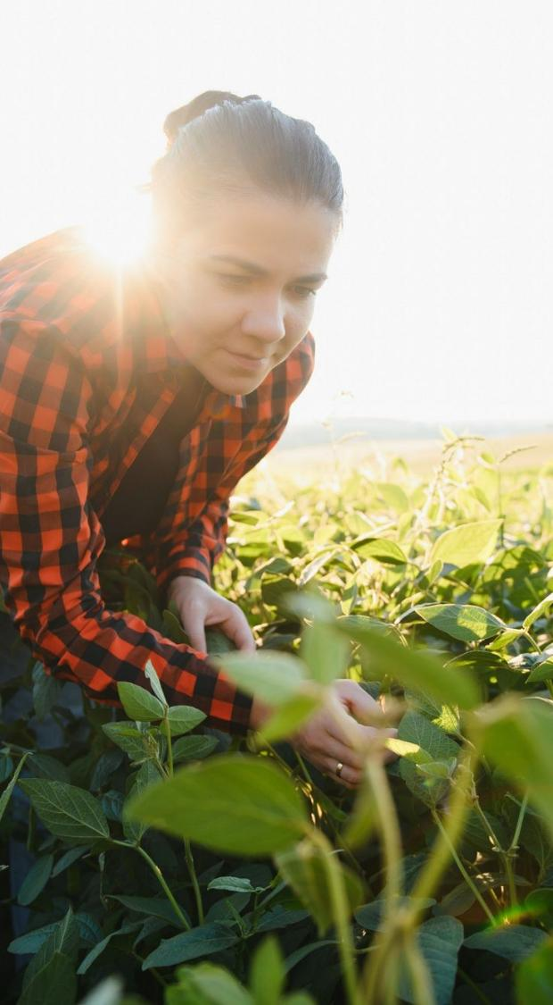
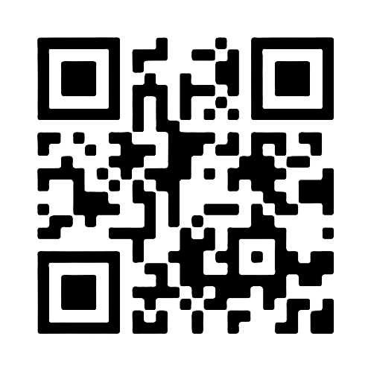
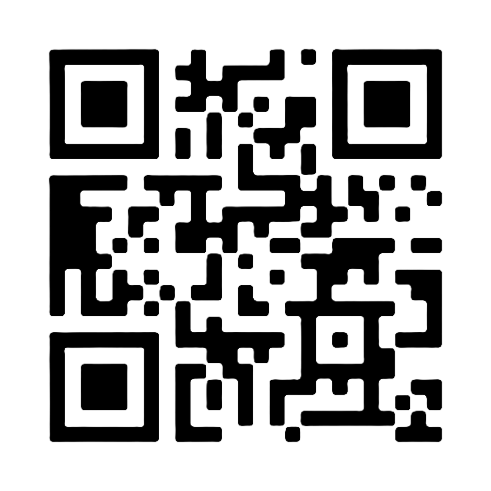
Watch our video case studies
Browse our full job profiles

Slide 78
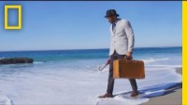
What will we do in our 4th second?
Notes:
https://www.youtube.com/watch?v=B-nEYsyRlYo&ab_channel=NationalGeographic

Slide 79
Questions?
info@greencareershub.com

Slide 80
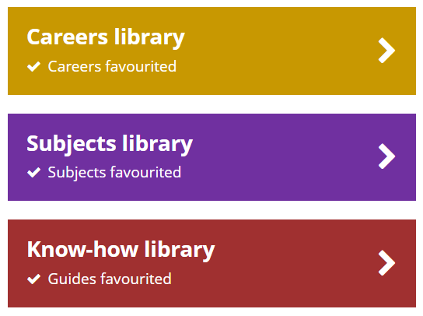
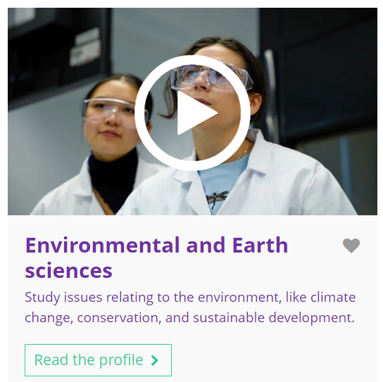


Go further with Unifrog resources
Careers library
Environmental planner
Subjects library
Environmental and earth sciences
Agriculture
Know-how library
Employer profile: Hertfordshire Zoo, a UK conservation charity
    Remember to click the heart symbol to add a profile or guide to your Favourites!
Notes:
Teacher’s notes:
This slide contains hyperlinks to career profiles, subject profiles, and Know-how library guides referenced in the quiz content.
Remember to log into the student side of your Unifrog account to access these links and remind students to favourite any profiles or guides they like the look of.
You can track student progress with favouriting profiles and guides by clicking Advanced>Sort by>Library profiles in Favourites.

Slide 81

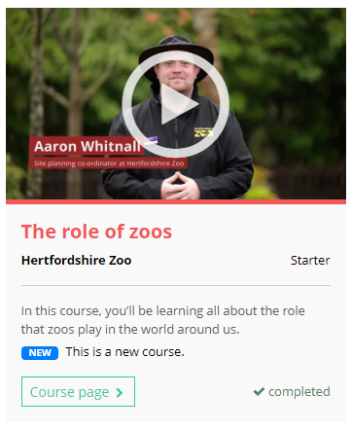
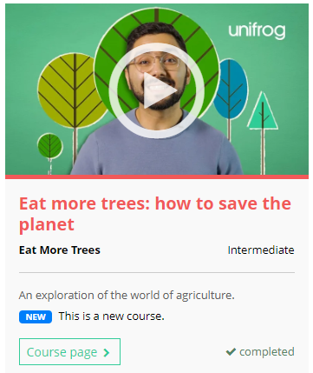
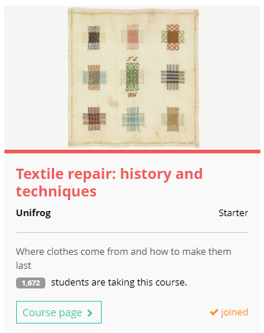
Further exploration
To explore the theme of sustainability further, check out these Unifrog courses:
Notes:
Teacher’s notes:
If you have additional time available and students have computer access, you can direct them to the Courses tool.

Slide 82
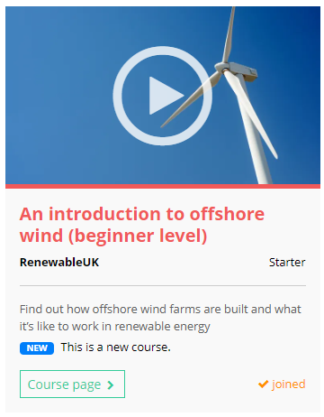
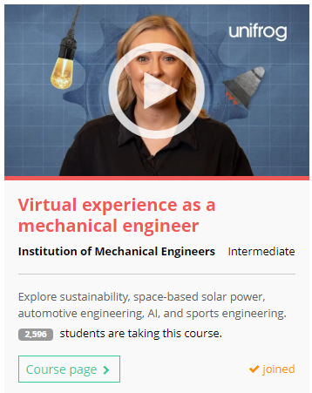
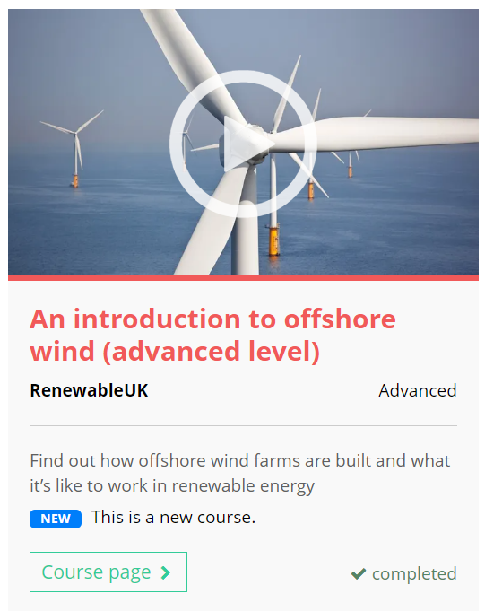
Further exploration
To explore the theme of sustainability further, check out these Unifrog courses:
Notes:
Teacher’s notes:
If you have additional time available and students have computer access, you can direct them to the Courses tool.

