Slide 1


Slide 2

https://www.amazingapprenticeships.com/resources/apprentices-are-amazing-film/

Slide 3
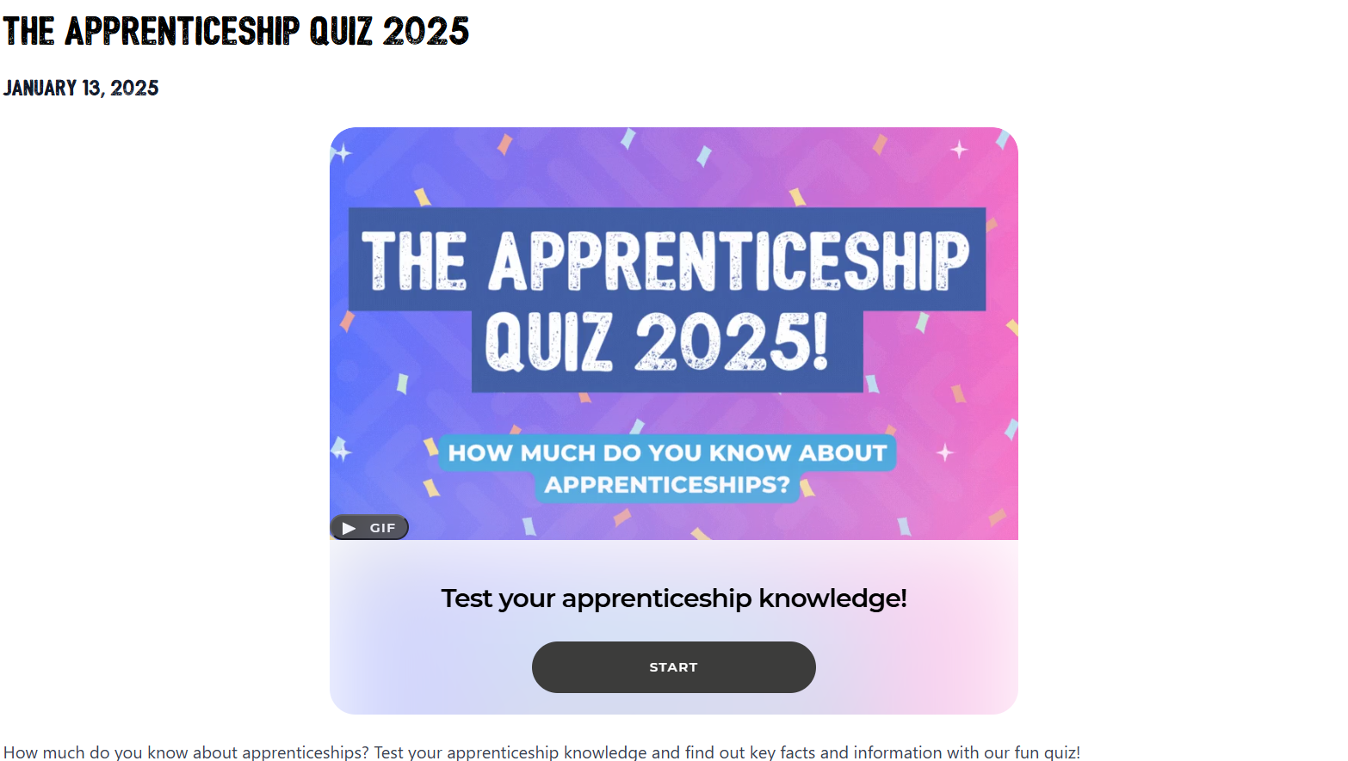
https://www.amazingapprenticeships.com/resources/the-apprenticeship-quiz-2025/

Slide 4
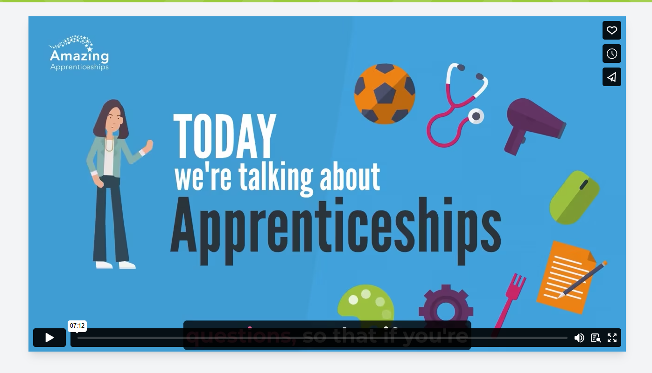
https://www.amazingapprenticeships.com/resources/the-apprenticeship-assembly-film/

Slide 5

Read all about it as a form…

Slide 6
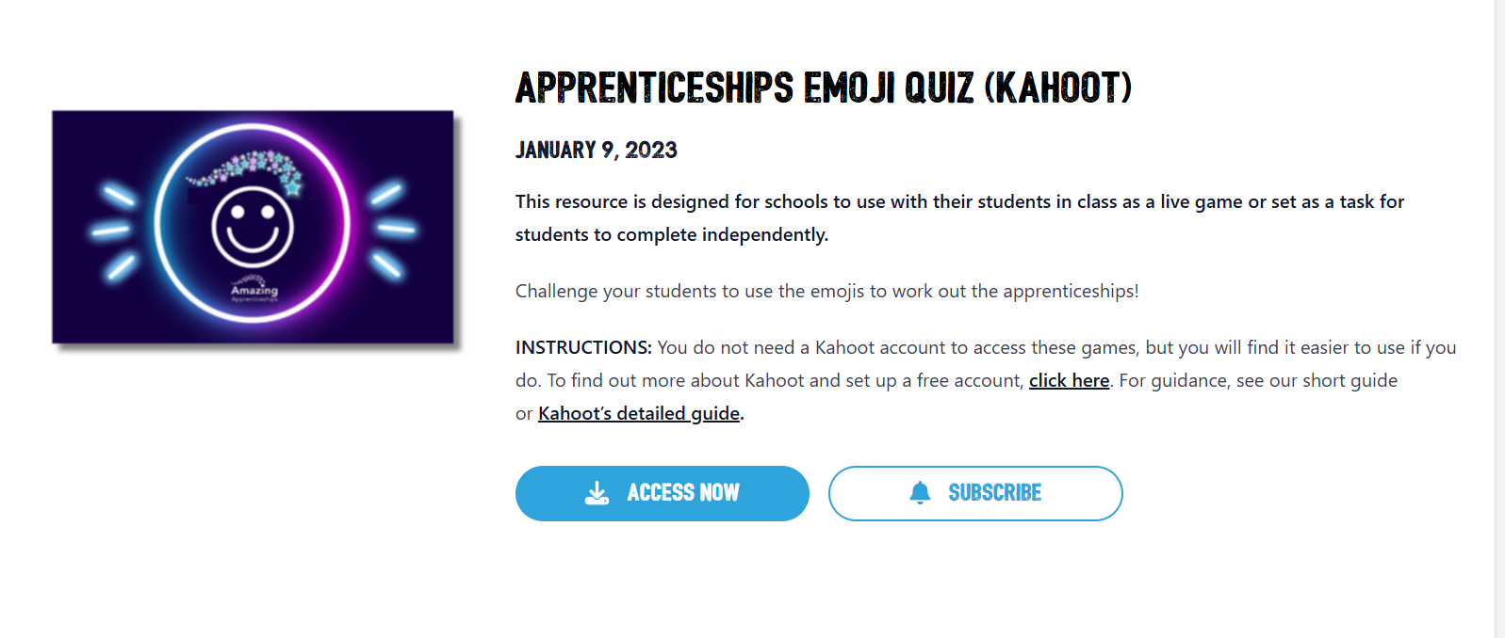
Google Classroom Homework Form Task
https://www.amazingapprenticeships.com/resources/apprenticeships-emoji-quiz-kahoot/

Slide 7
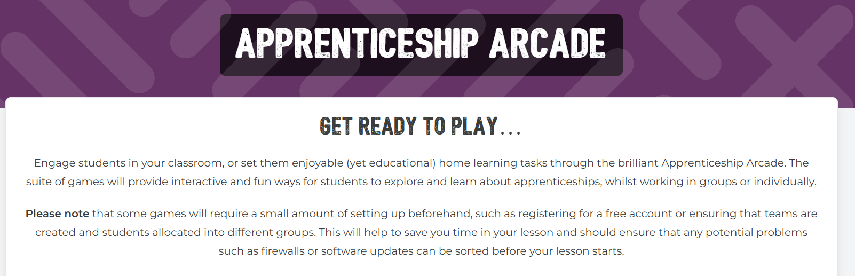
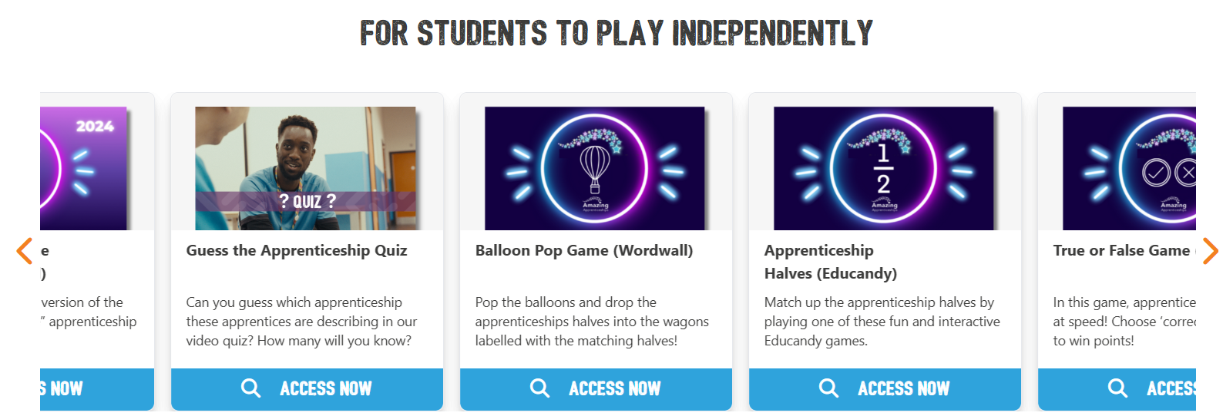
Engage with your mobiles
https://www.amazingapprenticeships.com/apprenticeship-arcade/

Slide 8


Online Events
https://nationalapprenticeshipweek.co.uk/events/understanding-your-apprenticeship-options-at-pwc/
https://www.amazingapprenticeships.com/events/exploring-the-range-of-apprenticeships/

Slide 9

Online Events
https://nationalapprenticeshipweek.co.uk/events/supporting-apprentices-inclusive-strategies-for-religious-observances/

Slide 10

Online Events
https://digdata.online/nhs-apprenticeship-live-recruitment-briefing/?utm_medium=email&_hsenc=p2ANqtz-_-9bcBtl3Ji8U0AmglCIMZ9BpbtjKZp3gtRbwnq3OeeOboPBtSoH7Nqy73ZQSjVmTKrBcSJ0X4qu6qOlaHhzvxVVLHAdA77l5bL69agRvQB5eBeCA&_hsmi=345426663&utm_content=345426663&utm_source=hs_email

Slide 11

Online Events
https://nationalapprenticeshipweek.co.uk/events/lets-talk-apprenticeships-meet-international-defence-company-babcock/

Slide 12

https://nationalapprenticeshipweek.co.uk/video/

Slide 13
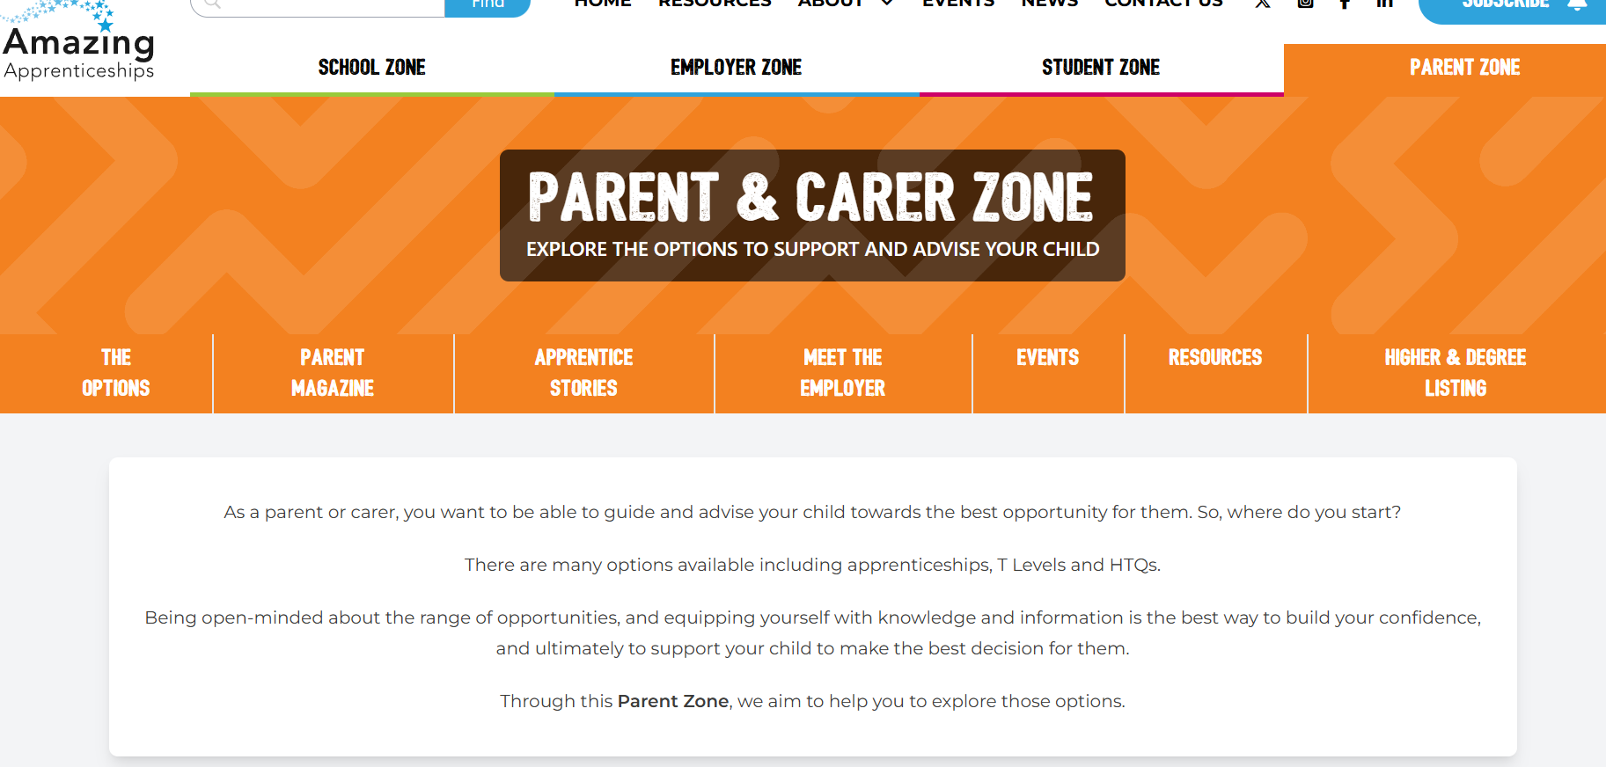
https://www.amazingapprenticeships.com/zones/parent/

Slide 14
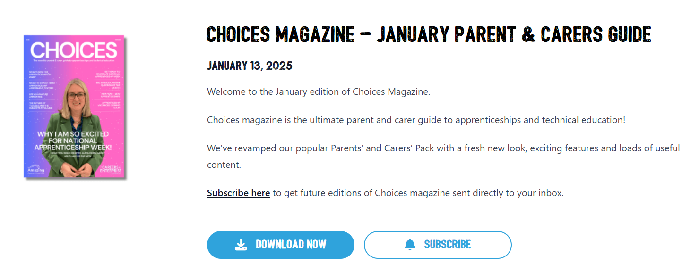
https://www.amazingapprenticeships.com/resources/choices-magazine-january-parent-carers-guide/

Slide 15

https://nationalapprenticeshipweek.co.uk/career-advice-hub/

Slide 16




https://nationalapprenticeshipweek.co.uk/win/

