Slide 1

Careers quiz: apprenticeships

Slide 2

Question one
In England, how many levels of apprenticeship are there?
Each ‘level’ reflects the stage of education that the apprentice has reached.
IMAGE PLACEHOLDER (inc blue border)
Two
Three
Four
Notes:
Teacher’s notes:
Click to display three possible answers for students to select from.
Click again to reveal the correct answer on the next slide.
Answers are recapped on slide twelve, after the five quiz questions have been presented.
If you would like to edit for your region:
Northern Ireland:
Level 2
Level 3
Higher level (Level 4-7)
Scotland:
Foundation
Modern (SCQF level 5, SCQF level 6/7, SCQF level 8/9, and SCQF level 10/11)
Graduate
Wales:
Foundation
Standard
Higher
Degree

Slide 3
Question one
In England, how many levels of apprenticeship are there?
Each ‘level’ reflects the stage of education that the apprentice has reached.
IMAGE PLACEHOLDER (inc blue border)
Four
Intermediate, advanced, higher, degree. Some may also award additional qualifications, such as a diploma.
Notes:
Teacher’s notes:
Answers are recapped on slide twelve, after the five quiz questions have been presented.
Students may also be aware of the following opportunities:
Traineeship: Level 1 or Level 2 (equivalent to GCSEs or below). These last a maximum of six months; they are unpaid but you gain skills and qualifications.
School Leaver Programme: Some employers run their own bespoke training programmes which give A level students the chance to gain a university degree and/or professional qualification (depending on the programme), while working for the company and earning a wage. Employers who do this include KPMG and PwC.
If you would like to edit for your region:
Northern Ireland:
Level 2
Level 3
Higher level (Level 4-7)
Scotland:
Foundation
Modern (SCQF level 5, SCQF level 6/7, SCQF level 8/9, and SCQF level 10/11)
Graduate
Wales:
Foundation
Standard
Higher
Degree

Slide 4

Question two
How long does an apprenticeship take to complete?
The exact time it takes will depend on the level, the sector, and whether you do it full-time or part-time.
IMAGE PLACEHOLDER (inc blue border)
Between one and three years
Between one and four years
Between one and five years
Notes:
Teacher’s notes:
Click to display three possible answers for students to select from.
Click again to reveal the correct answer on the next slide.
Answers are recapped on slide twelve, after the five quiz questions have been presented.

Slide 5
Question two
How long does an apprenticeship take to complete?
The exact time it takes will depend on the level, the sector, and whether you do it full-time or part-time.
IMAGE PLACEHOLDER (inc blue border)
Between one and five years
For example, an Intermediate Level 2 Apprenticeship usually takes around 12 to 18 months and an Advanced Level 3 Apprenticeship around 24 months.
Notes:
Teacher’s notes:
Answers are recapped on slide twelve, after the five quiz questions have been presented.

Slide 6

Question three
During your apprenticeship, if you’re under 18, you shouldn’t be expected to work for more than an average of:
IMAGE PLACEHOLDER (inc blue border)
36 hours a week
40 hours a week
48 hours a week
Notes:
Teacher’s notes:
Click to display three possible answers for students to select from.
Click again to reveal the correct answer on the next slide.
Answers are recapped on slide twelve, after the five quiz questions have been presented.

Slide 7
Question three
During your apprenticeship, if you’re under 18, you shouldn’t be expected to work for more than an average of:
IMAGE PLACEHOLDER (inc blue border)
40 hours a week
You’re also entitled to at least one 20-minute break for every six hours that you work, and 11+ hours off between shifts.
Notes:
Teacher’s notes:
Answers are recapped on slide twelve, after the five quiz questions have been presented.
If you’re 18 or over, this limit increases to 48 hours per week.

Slide 8

Question four
At what age are you entitled to the National Minimum Wage when working as an apprentice?
This is on the basis that you are working a minimum of 30 hours a week.
IMAGE PLACEHOLDER (inc blue border)
Age 19
Age 21
Age 22
Notes:
Teacher’s notes:
Click to display three possible answers for students to select from.
Click again to reveal the correct answer on the next slide.
Answers are recapped on slide twelve, after the five quiz questions have been presented.

Slide 9
Question four
At what age are you entitled to the National Minimum Wage when working as an apprentice?
This is on the basis that you are working a minimum of 30 hours a week.
IMAGE PLACEHOLDER (inc blue border)
Age 19
You’re entitled to the National Minimum Wage if you are aged 19 or over and have completed the first year of your apprenticeship.
Notes:
Teacher’s notes:
Answers are recapped on slide twelve, after the five quiz questions have been presented.

Slide 10

Question five
What is the typical breakdown of apprenticeships?
For example, the time spent completing ‘on-the-job’ training and the time spent studying.
IMAGE PLACEHOLDER (inc blue border)
60% training, 40% studying
70% training, 30% studying
80% training, 20% studying
Notes:
Teacher’s notes:
Click to display three possible answers for students to select from.
Click again to reveal the correct answer on the next slide.
Answers are recapped on slide twelve, after the five quiz questions have been presented.

Slide 11
Question five
What is the typical breakdown of apprenticeships?
For example, the time spent completing ‘on-the-job’ training and the time spent studying.
IMAGE PLACEHOLDER (inc blue border)
80% training, 20% studying
The majority of your time will be spent in the workplace, for example, four days in the workplace and one day spent studying per week.
Notes:
Teacher’s notes:
Answers are recapped on slide twelve, after the five quiz questions have been presented.

Slide 12
Answers
1 = C
2 = C
3 = B
4 = A
5 = C
c) Four levels, intermediate, advanced, higher, degree. Some may also award additional qualifications, such as a diploma.
c) Between one and five years, for example, an Intermediate Level 2 Apprenticeship takes around 12-18 months and an Advanced Level 3 Apprenticeship 24 months.
b) 40 hours a week, with one 20-minute break for every six hours that you work, and 11+ hours off between shifts.
a) Age 19, if you’ve also completed the first year of your apprenticeship.
c) 80% training, 20% studying, the majority of your time will be spent in the workplace, e.g. four days in the workplace and one day spent studying per week.
Notes:
Teacher’s notes:
Click to recap the five quiz question answers and supporting explanations.

Slide 13



Unifrog resources
Know-how library
UK apprenticeships: know your rights
UK apprenticeships: how much will I earn?
Is a UK Apprenticeship right for me?
University and apprenticeships: what's the difference?
A guide to degree apprenticeships
    Remember to click the heart symbol to add a guide to your Favourites!
Notes:
Teacher’s notes:
This slide contains hyperlinks to Know-how library guides referenced in the quiz content.
Remember to log into the student side of your Unifrog account to access these links and remind students to favourite any guides they like the look of.
You can track student progress with favouriting Know-how library guides by clicking Advanced>Sort by>Library profiles in Favourites.

Slide 14
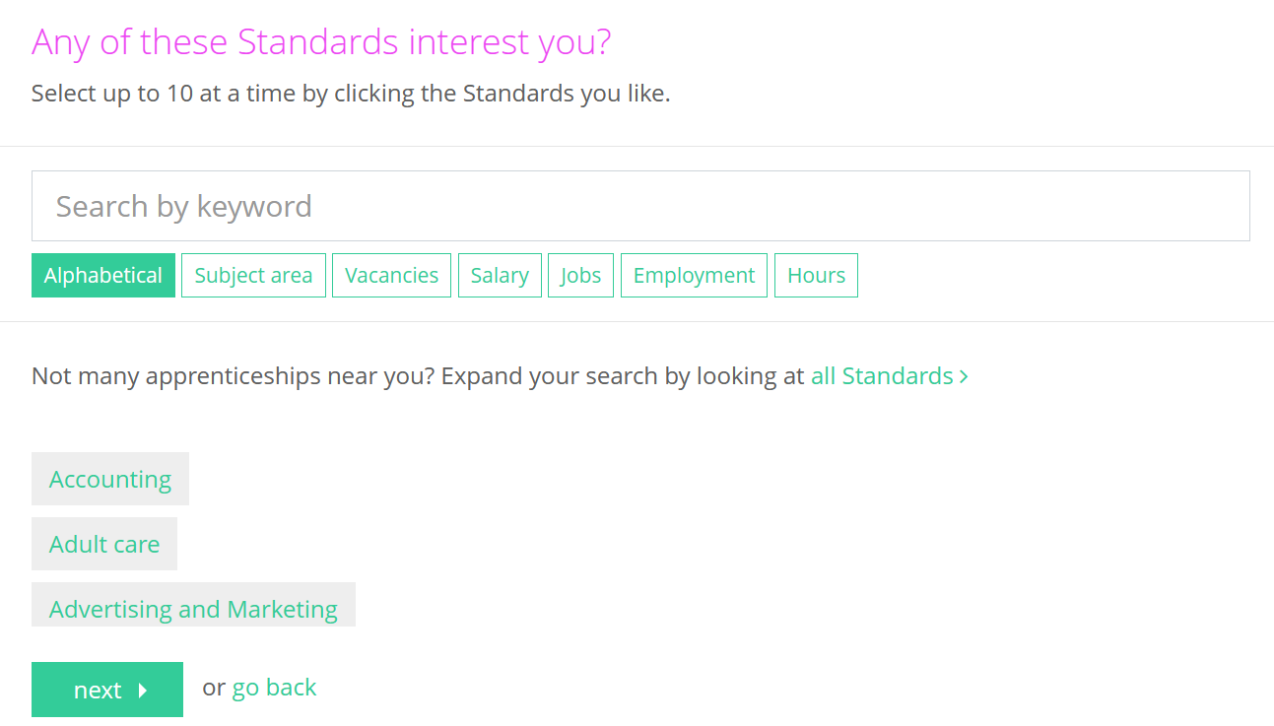

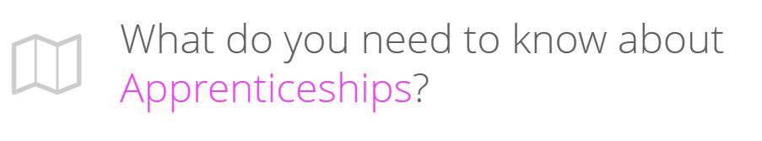
Further exploration
You can use the Apprenticeships tool to see an overview of everything you need to know about apprenticeships, as well as search for vacancies.
Notes:
Teacher’s notes:
If you have additional time available and students have computer access, you can direct them to the Apprenticeships tool.

Slide 15


