Slide 1

GREEN CAREERS WEEK
LESSON

Slide 2

5 MINS
INTRODUCTION TO GREEN CAREERS WEEK

Slide 3
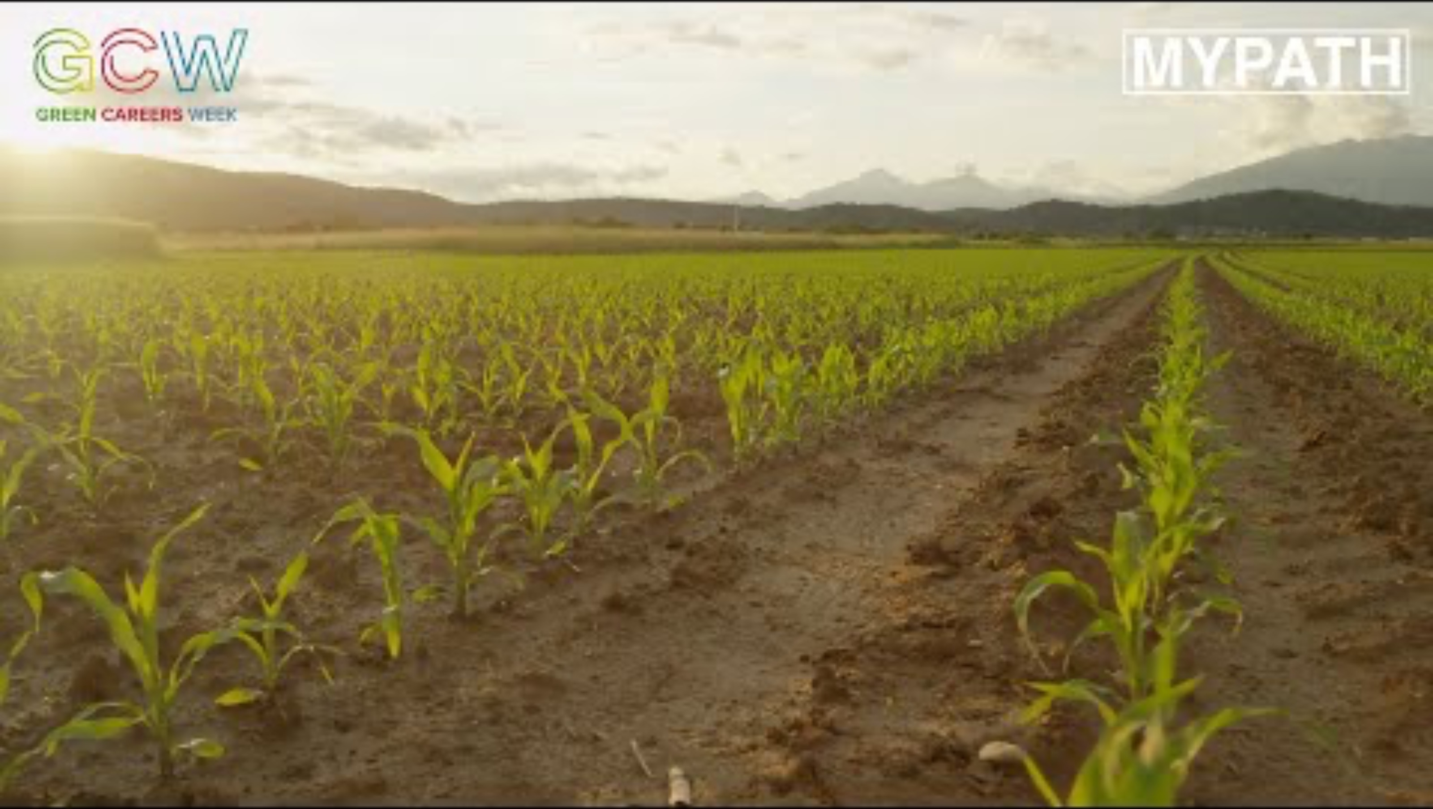
5-15 MINS
THE IMPACT OF CLIMATE CHANGE ON CAREERS

Slide 4

5-10 MINS
WHAT JOBS ARE BECOMING MORE GREEN-FOCUSED?

Slide 5

5 MINS
WHAT SKILLS WILL YOU NEED FOR
THESE NEW GREEN JOBS?

Slide 6

1 MIN
GREEN CAREERS WEEK

