Slide 1
Based on this image, what do you think a
Heat Network Specialist might do?
BELL TASK

Slide 2
What are your ideas?

Slide 3
Working With Others.
MLO: To learn about a new career option.
To design a job specification for a Heat Network Specialist.

Slide 4
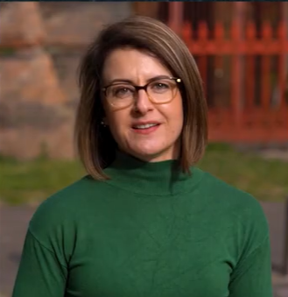
As we watch Tharina’s video, jot down some questions and ideas that come to you. What do you like about her job? What would you like to know?

Slide 5
What do you think?
Did anything surprise you about the video?
Do you know anybody who does this job?
Do you know anybody who does a SIMILAR kind of job?
Does this remind you of any other jobs you know about?
Would you like to do this job?

Slide 6
Let’s make a recipe…
Tharina described her job as being a lot like BAKING – she brings together ingredients and mixes them to create a solution and a relationship.
Let’s think about YOU and what you want from the future.
Which INGREDIENTS are you going to need?
What will you ‘make’ if you follow the recipe?

Slide 7
Here’s my recipe for a great teacher…
Take a pinch of knowledge.
Add a scoop of inspiration.
Mix together with a pint of patience.
Sieve in ten ounces of enthusiasm.
Sprinkle in a generous spoonful of hope for the future.
Stir together with a handful of love for the subject.
Spread fairly between hundreds of students every day.
Bake in a classroom filled with good attitudes.

Slide 8
Now it’s your turn!
Think about your personal qualities, the future you’d like, and the things you could ‘mix in’ to create your own recipe.
A pint of careers advice?
A tablespoon of research into my dream job?
6 ounces of extracurricular activity?

Slide 9
What do you think a JOB SPECIFICATION is?
Have a look at the examples provided.

Slide 10
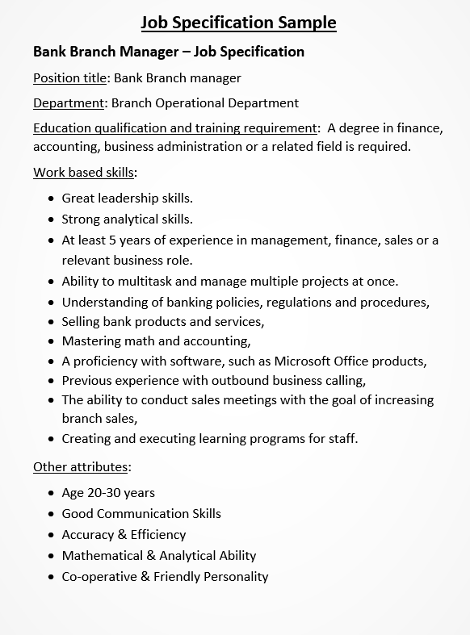
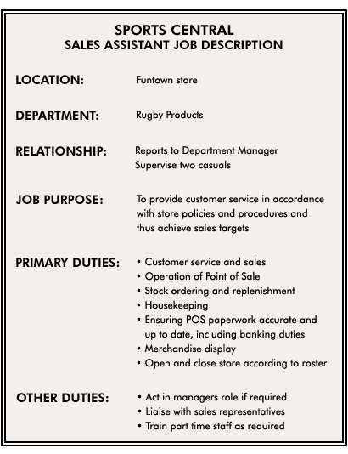

Slide 11
Now it’s your turn!
Using the headings from the examples, can you create a JOB SPECIFICATION for Tharina’s role?
Or for one of the other jobs we’ve seen in our lessons?
Think about personal skills, education, expectations, responsibilities and location.

Slide 12
Finally…Share your job specification with another person/pair/group.
Used headings from the examples? | Y/N
Made it clear what the job role is? | Y/N
Included a range of skills and duties? | Y/N
Made it clear what kind of person they are looking for? | Y/N
Chosen suitable details for the job they are advertising? | Y/N

