Slide 1
There are 7 main types of engineering:
MECHANICAL
ELECTRICAL
SOFTWARE
FIRMWARE
AEROSPACE
CIVIL
CHEMICAL
Can you match each type of engineering to the images on your worksheet?
BELL TASK
Challenge Task:
Can you add notes to explain WHY you’ve made these matches?

Slide 2
Let’s find out what you think…

Slide 3
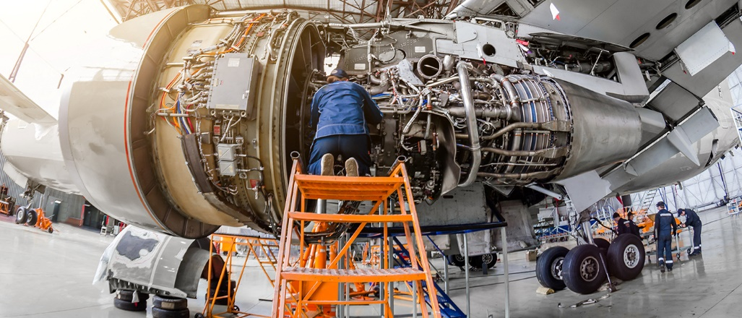
Aerospace Engineer

Slide 4
Chemical Engineer

Slide 5
Civil Engineer

Slide 6
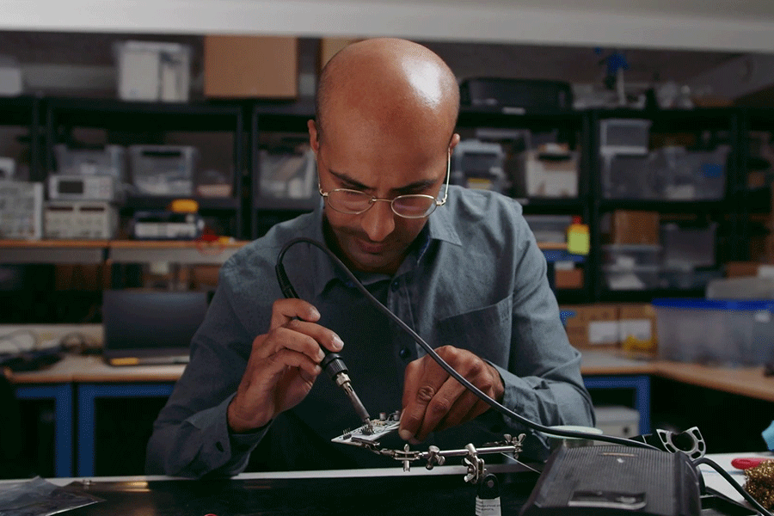
Firmware Engineer

Slide 7
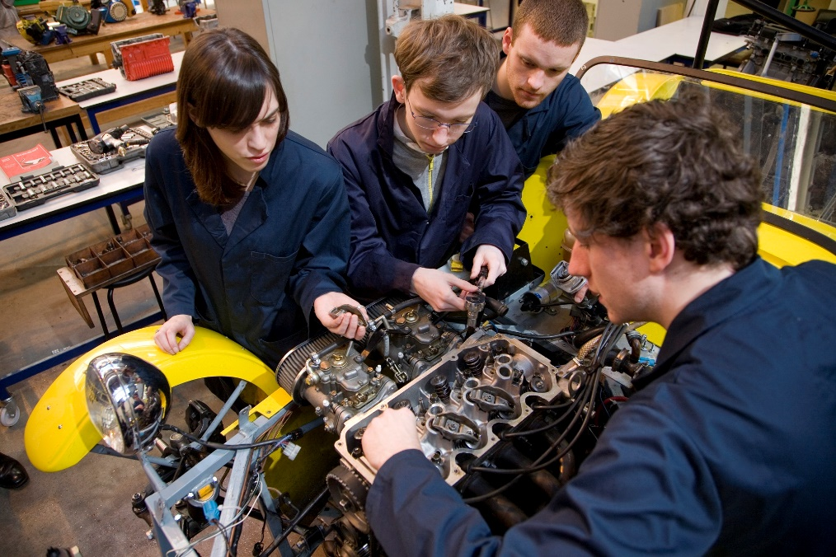
Mechanical Engineer

Slide 8
Software Engineer

Slide 9
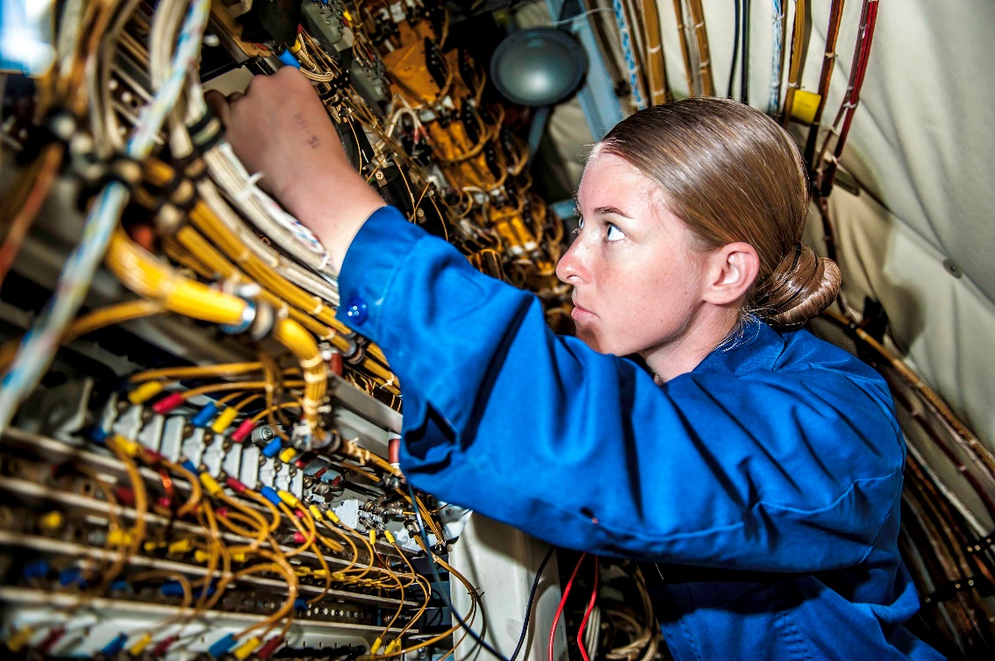
Electrical Engineer

Slide 10
Which type of engineer interests you the most?
What QUALITIES do you think an engineer of any sort needs?

Slide 11
Engineering Managers.
MLO: To know about the different types of ENGINEER.
To hear from a real engineer about their job and what they do.
To solve a problem, despite the obstacles.

Slide 12
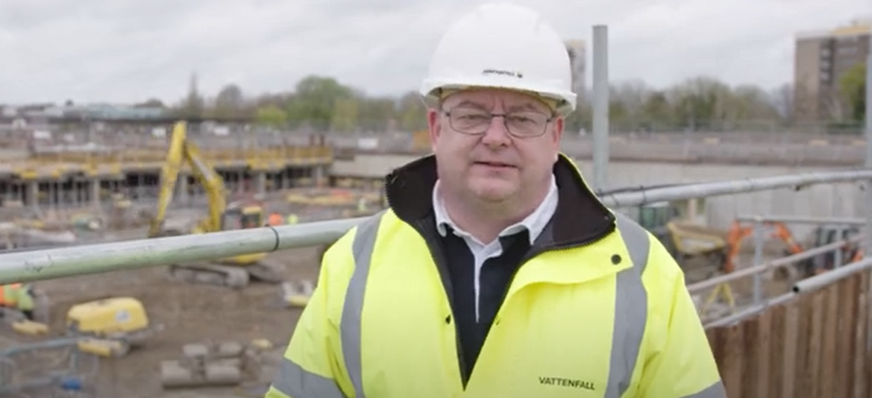
Let’s meet Steve. He’s an ENGINEERING MANAGER.
What KIND of engineer is Steve?

Slide 13
Are you ready for a challenge?
Can you think creatively?
Can you change your plans when you get new information?
Can you work under pressure?

Slide 14
We need disabled access to an upstairs classroom in our building.
To make our school more accessible, we need to come up with a way to make our upstairs classrooms accessible to students in wheelchairs or with other mobility needs.
In your groups, you have TEN MINUTES to come up with a solution to this issue.

Slide 15
I hate to interrupt you but... There’s a problem!
The structure of the building isn’t strong enough to hold any new machinery.
What do you need to do to solve this new problem?

Slide 16
Uh-oh! There’s another slight issue…
Some of the students needing access get scared in enclosed spaces.
Does this problem affect your solution? What needs to change?

Slide 17
Just one other thing…
The solution you come up with needs to be GREEN and ENERGY-EFFICIENT, or it won’t get funding.
How can you solve this issue?

Slide 18
Let’s hear your solutions!
You can present them however you like –
Come to the front.
Move around different groups.
One person from each group moves around to see each solution.
Each group presents from their area.

Slide 19
Let’s evaluate…

Slide 20
Which job do you like the look of the most and why?
Energy Engineer
Commercial Modeller
Engineering Manager

