Slide 1
Student Support for logging on to emails
As a student you will need to type lgfl mail student login in Google. It is the first link to show up.

Slide 2
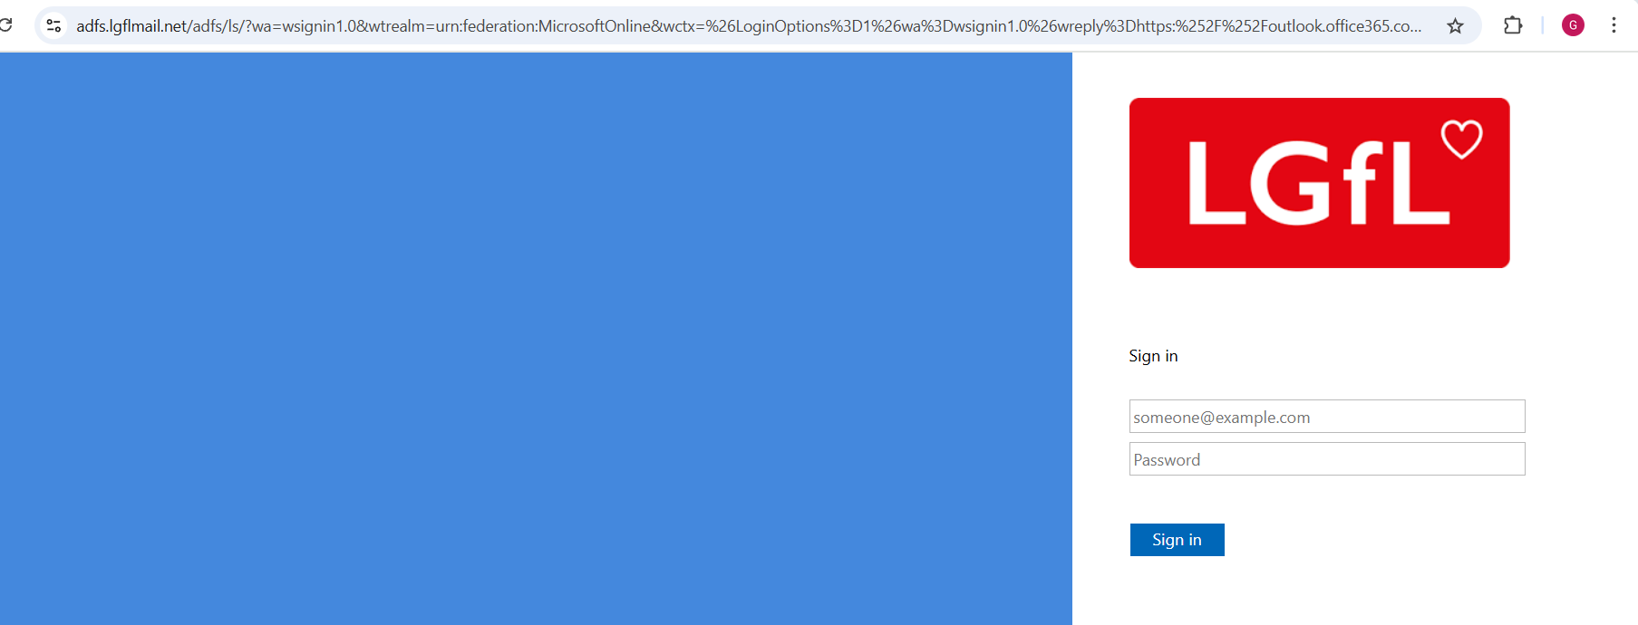
Pastoral Support for email credentials
Students will use their login credentials to sign in. For this example we will use Adetokunbo.
adeba206.203@lgflmail.net
password

Slide 3
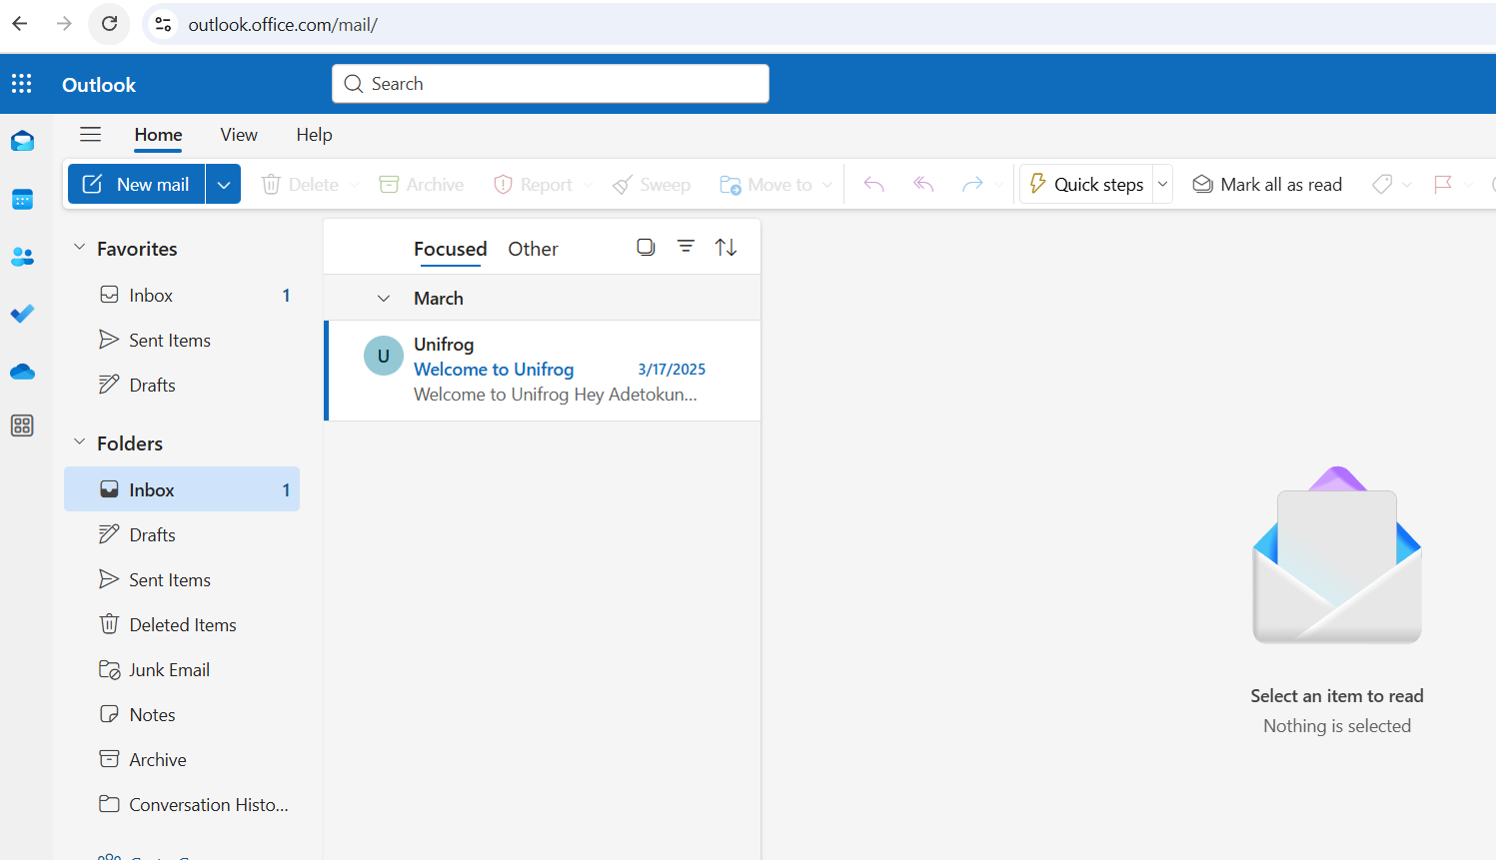
Pastoral Support for email credentials
This student will then be able to login and see the welcome email from Unifrog.

Slide 4
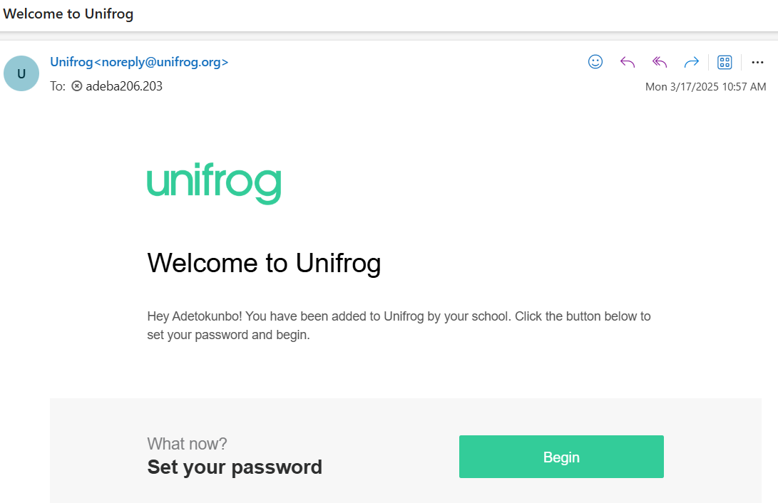
Pastoral Support for email credentials
When you have the welcome email, click on the button below to begin. It will take you to the Unifrog website.

Slide 5
Pastoral Support for email credentials
When you have the welcome email, click on the button below to begin. It will take you to the Unifrog website.

Slide 6
Pastoral Support for email credentials
Re-enter your lgfl mail email. This will send you an email to your lgfl mail inbox.

Slide 7
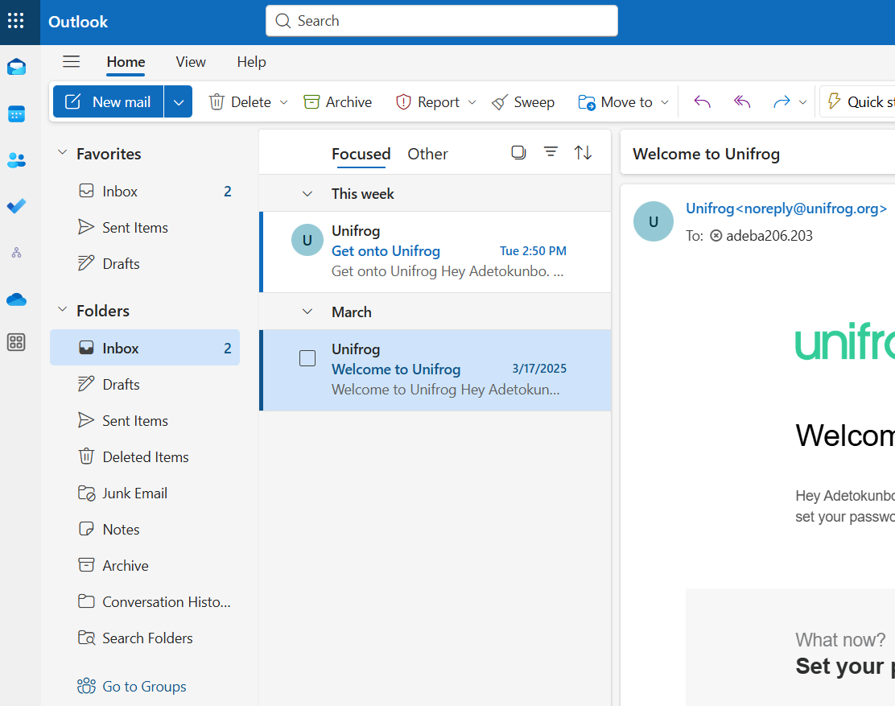
Pastoral Support for email credentials
Access the email at the top of your inbox from Unifrog. This should now have your credentials to log in and create a password for Unifrog.

Slide 8
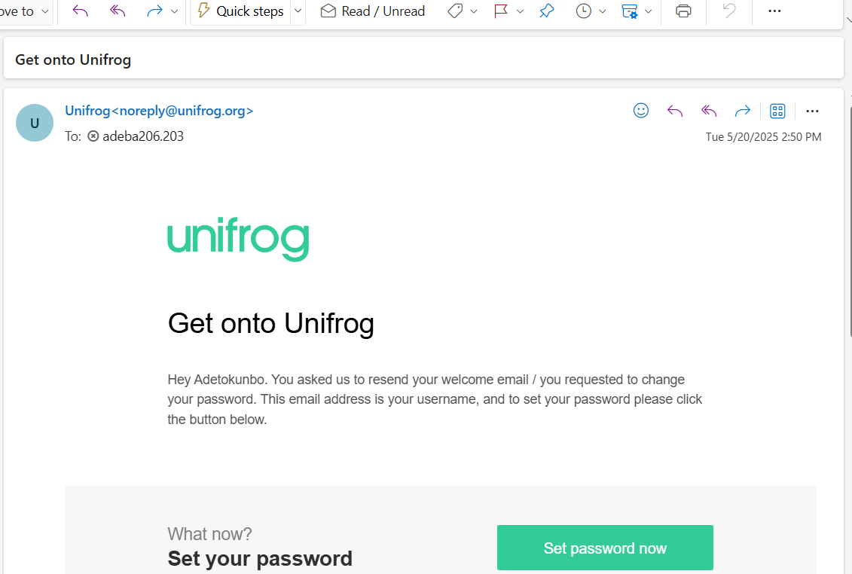
Pastoral Support for email credentials
This is what the email should look like below. This should now provide you with resetting your password.

Slide 9
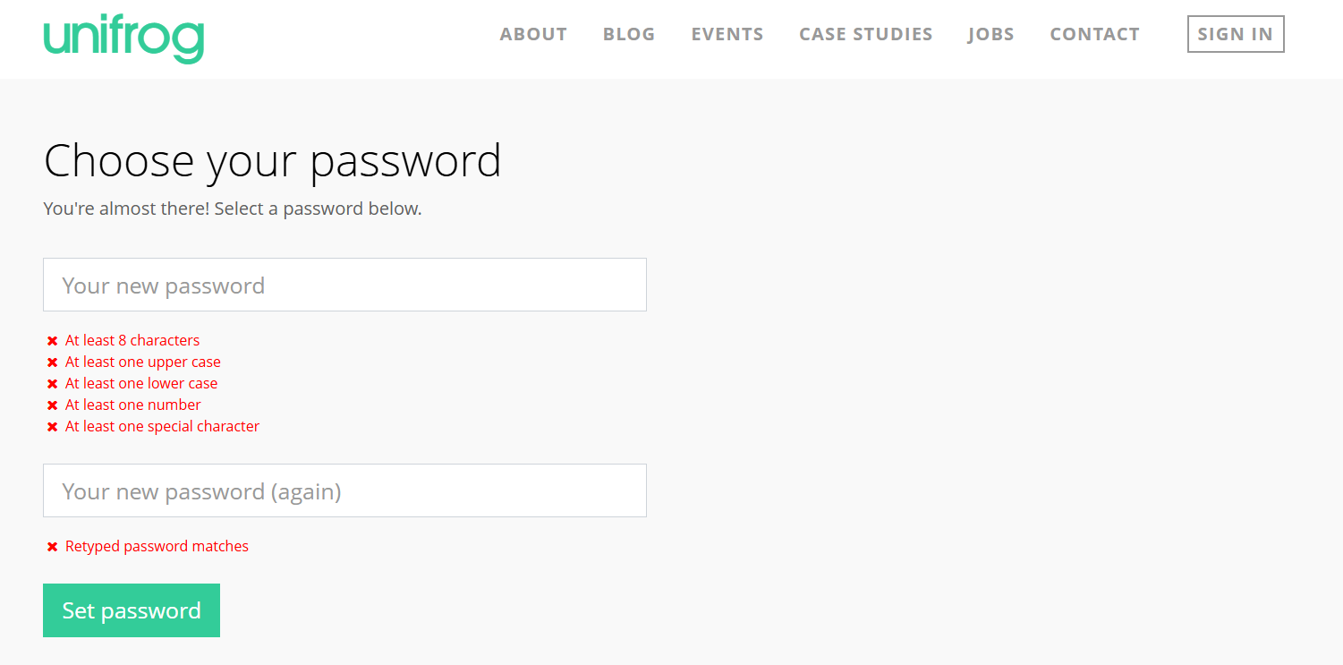
Pastoral Support for email credentials
The email will take you through to the Unifrog website to set a password. Choose one that you can remember but you can all reset the password to your email if forgotten.

Slide 10
Pastoral Support for email credentials
When you have reset the password, press the button to log in with your username and password.

Slide 11
Launching Unifrog
11-14

Slide 12
Welcome to Unifrog!
During today’s session, we will…
Watch a video to find out about Unifrog
Sign in to Unifrog
Complete the ‘Unifrog 101’ course to learn how to use the platform
Notes:
Teacher’s notes:
Slide 3 contains a launch video to introduce students to Unifrog, specifically designed for 11–14-year-olds.
Slide 4 allows you to select whether you’re using the welcome email method or Sign up Code method to create Unifrog accounts.
The remainder of the slides contain instructions for students to create their Unifrog accounts and complete the Unifrog 101 course, specifically designed for 11-14 year-olds.
Slides 5-17 are for schools who are using the welcome email method.
Slides 18-32 are for schools who are using the Sign up Code method.

Slide 13
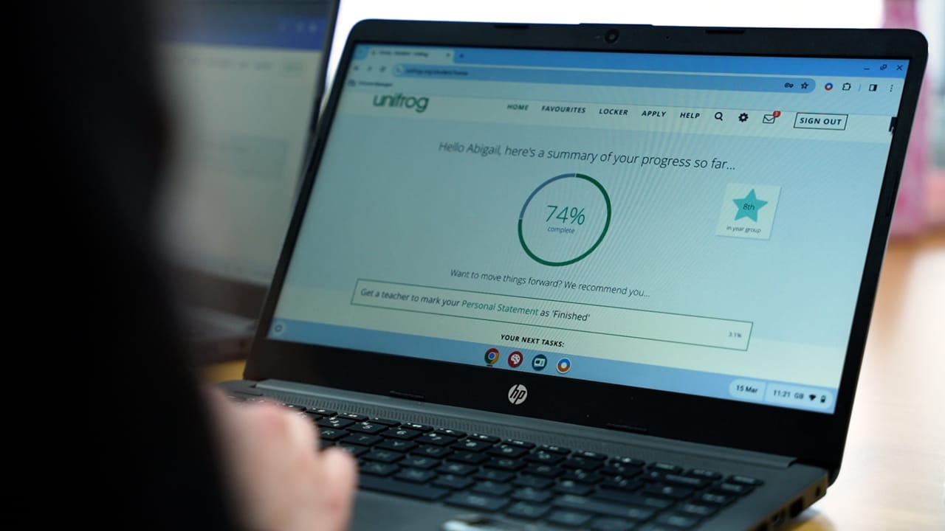
Staff please log in to Unifrog to access video
Click the image above to open the Unifrog launch video

Slide 14
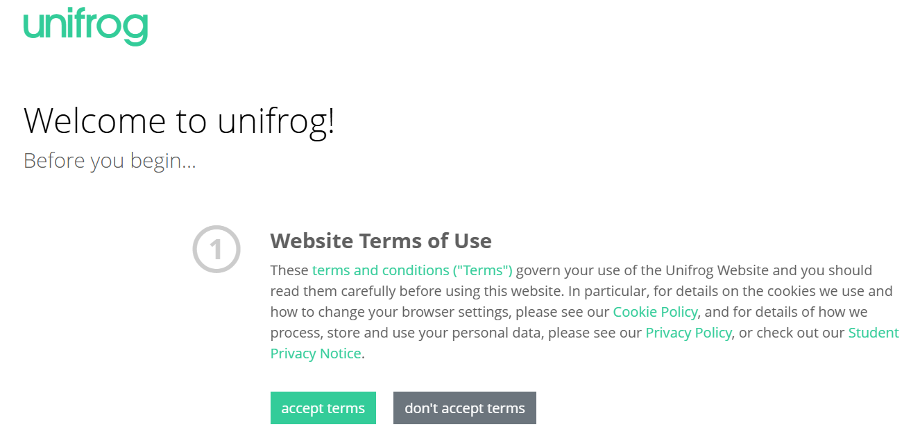
Pastoral Support for email credentials
Accept the term and conditions.

Slide 15
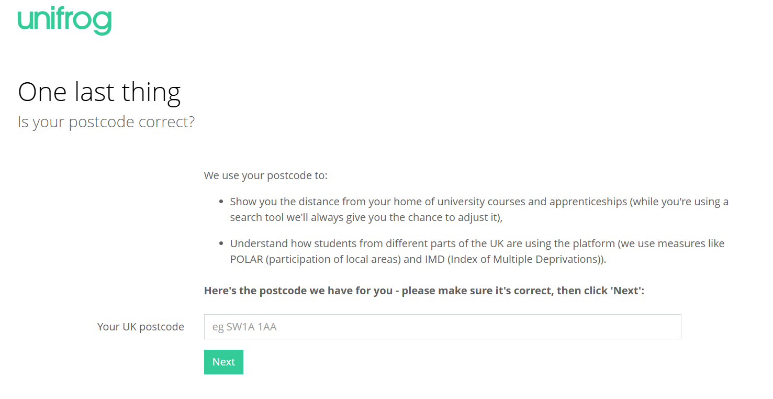
Pastoral Support for email credentials
Record your home postcode and then press next.

Slide 16
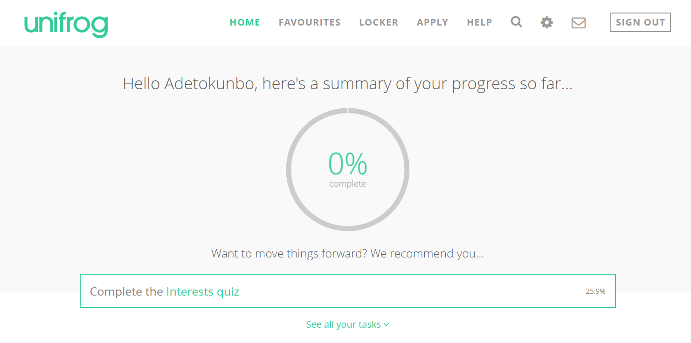
Pastoral Support for email credentials
For the first task complete the Interest Quiz. You will also need to complete the 101 quiz. If both are recorded you will receive a Silver award on Edulink.

Slide 17
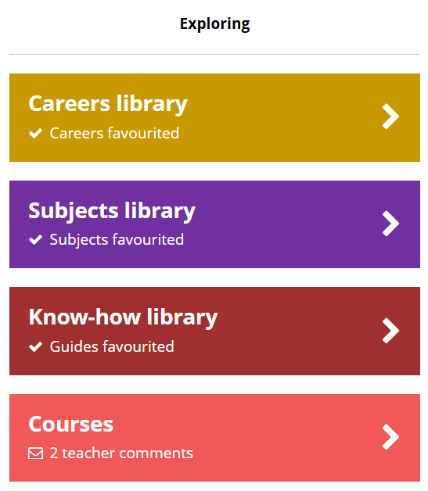
Learning how to use Unifrog
From your Unifrog homepage, scroll down to ‘Exploring.’
If you don’t see the Courses tool straight away, click ‘All tools’.

Slide 18
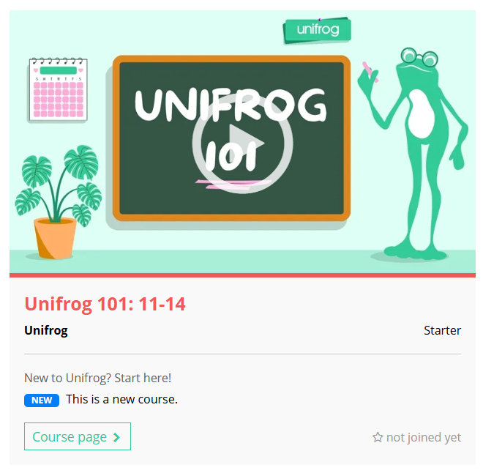
Learning how to use Unifrog
When you’re on the Courses tool, scroll down to the keyword search bar.
Type in ‘101’ and click ‘Go’.
101
You’ll then see the Unifrog 101 course! Click ‘Course page’.

Slide 19
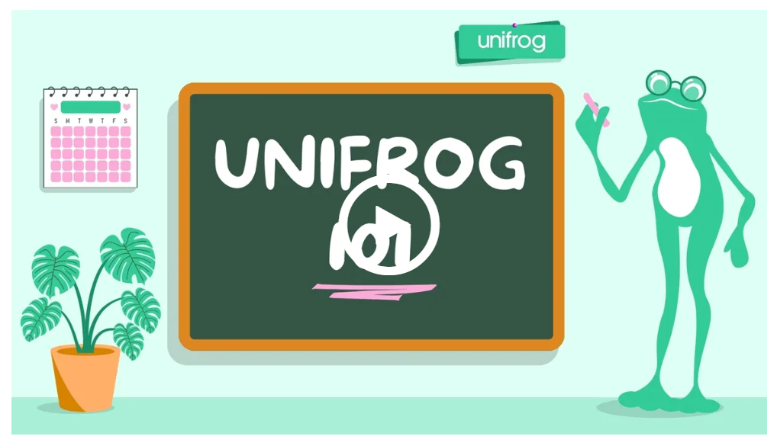
Learning how to use Unifrog
On the course page, you can watch a short intro video about the 101 course.

Slide 20
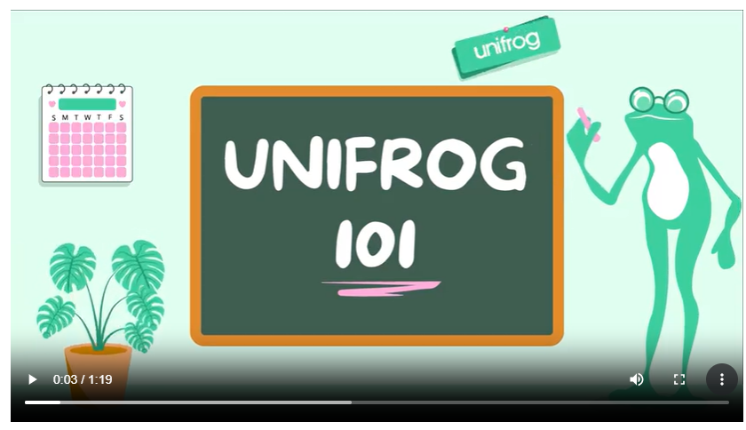
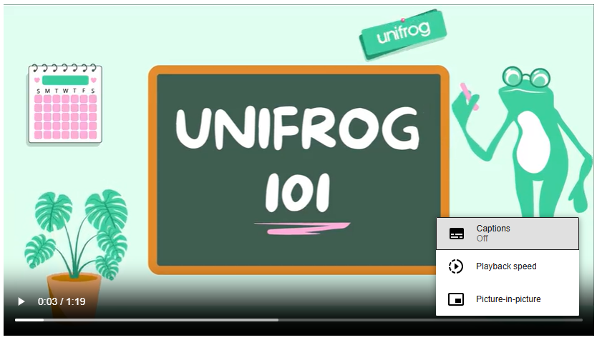
Learning how to use Unifrog
Once the video starts to play, you can turn on the captions using the three dots.

Slide 21
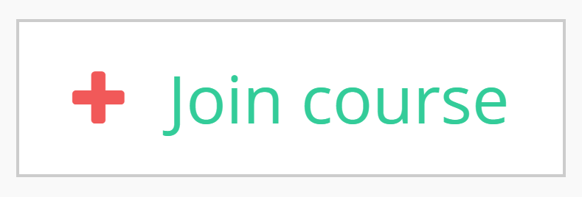
Learning how to use Unifrog
When you’re ready to get started, click ‘Join course’.

Slide 22
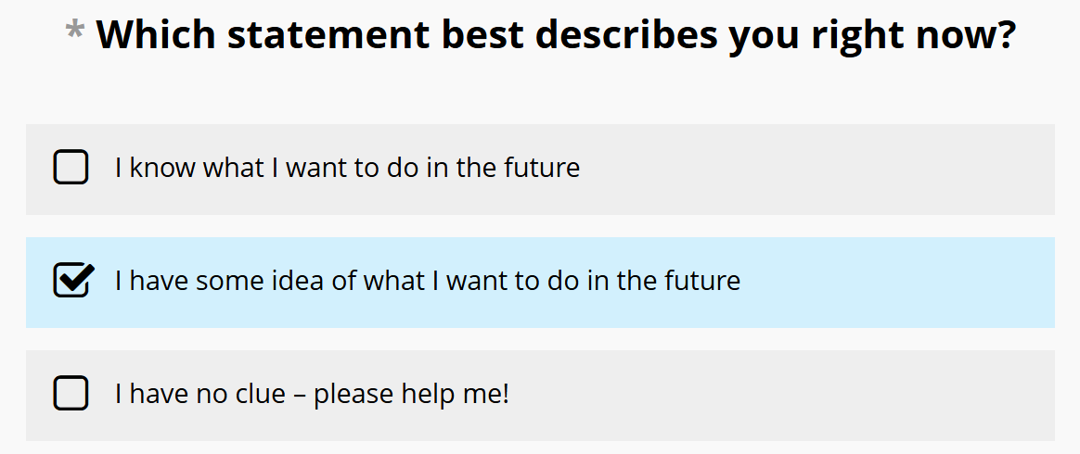
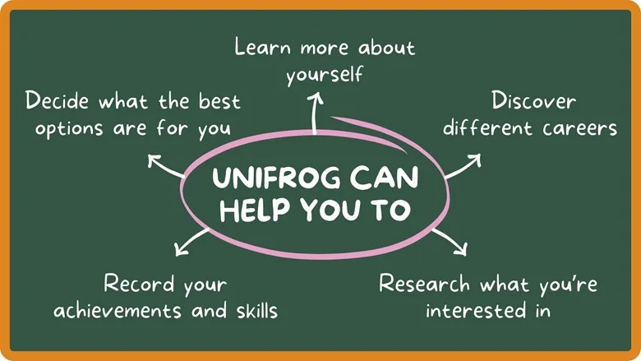
Learning how to use Unifrog
You’ll then have access to session 1! Click ‘Session page’.
Each session has some short videos to watch, things to read, and activities to complete to help you explore Unifrog.

Slide 23
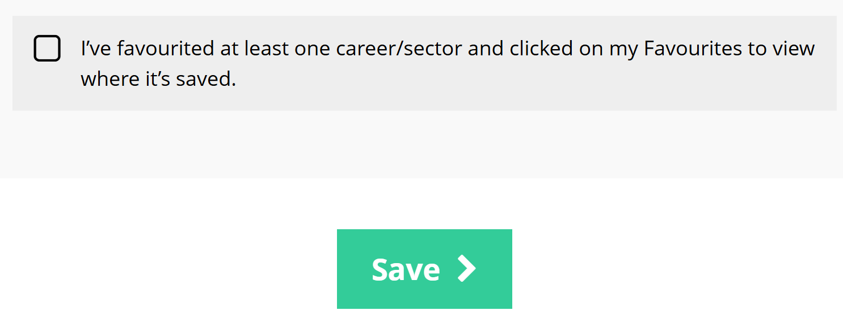
Learning how to use Unifrog
Once you’ve finished the activities in the session 1, tick the checkbox and click ‘Save’.

Slide 24
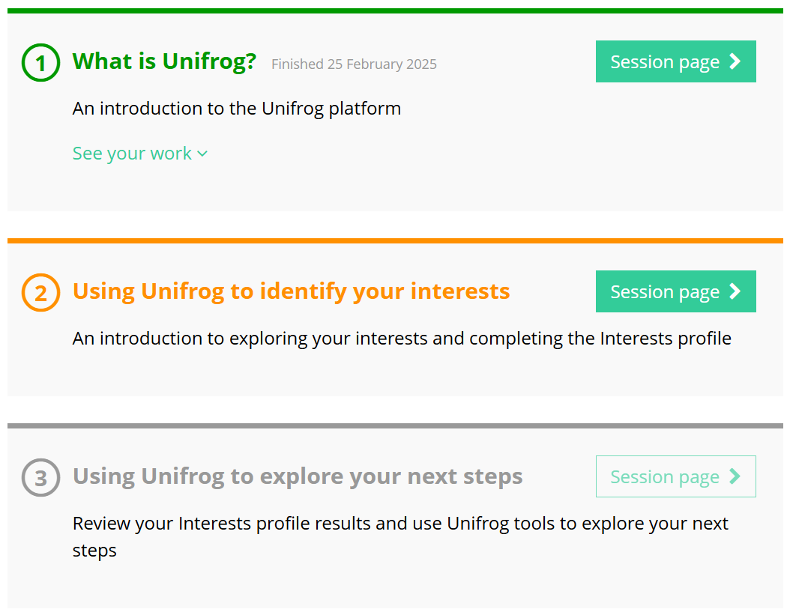
Learning how to use Unifrog
You’ll then be able to access session 2.
Keep going until you’ve completed all sessions!

Slide 25
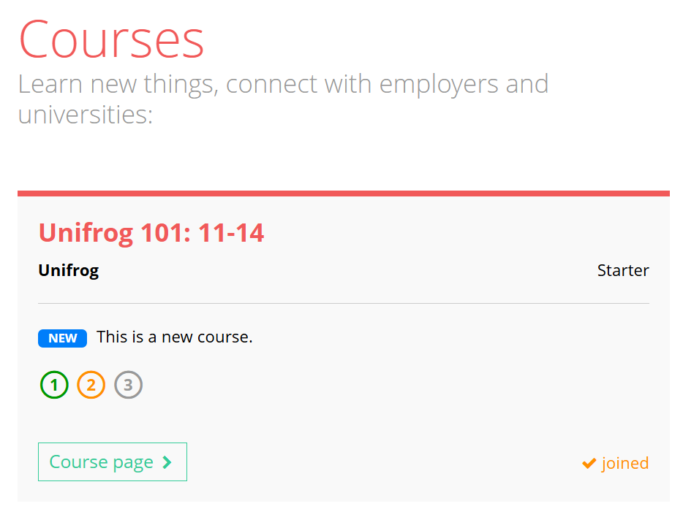
Learning how to use Unifrog
Finished the Unifrog 101 course early?
Check out the last page of your completion certificate for more ways to explore what Unifrog has to offer!
Didn’t get time to finish today?
Don’t worry – you can pick up where you left off next time you log in to Unifrog.

Slide 26
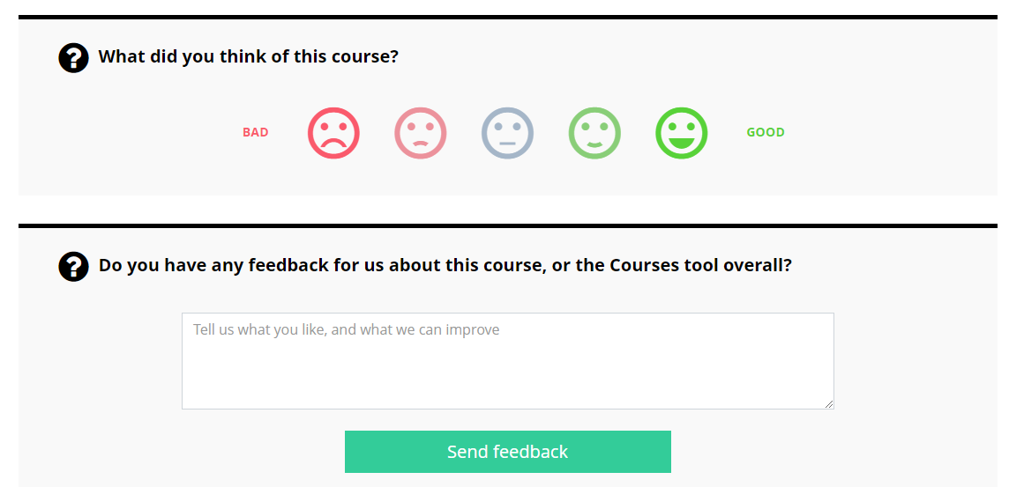
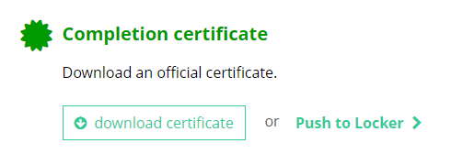
Learning how to use Unifrog
Once all sessions are completed, you’ll be asked for some feedback and you can download your course completion certificate.
I think this course was…

